Slide 1
Mon., Oct. 21

Slide 2
responding to a complaint…

Slide 3
default

Slide 4
pleadings

Slide 5
FRCP 7. Pleadings Allowed; Form of Motions and Other Papers (a) Pleadings. Only these pleadings are allowed: (1) a complaint; (2) an answer to a complaint; (3) an answer to a counterclaim designated as a counterclaim; (4) an answer to a crossclaim; (5) a third-party complaint; (6) an answer to a third-party complaint; and (7) if the court orders one, a reply to an answer.

Slide 6
answers

Slide 7
preanswer motions

Slide 8
FRCP 12(b) How to Present Defenses. Every defense to a claim for relief in any pleading must be asserted in the responsive pleading if one is required. But a party may assert the following defenses by motion: (1) lack of subject-matter jurisdiction; (2) lack of personal jurisdiction; (3) improper venue; (4) insufficient process; (5) insufficient service of process; (6) failure to state a claim upon which relief can be granted; and (7) failure to join a party under Rule 19.

Slide 9
timing

Slide 10
FRCP 12(a) Time to Serve a Responsive Pleading. (1) In General. Unless another time is specified by this rule or a federal statute, the time for serving a responsive pleading is as follows: (A) A defendant must serve an answer: (i) within 21 days after being served with the summons and complaint; or (ii) if it has timely waived service under Rule 4(d), within 60 days after the request for a waiver was sent . . . (B) A party must serve an answer to a counterclaim or crossclaim within 21 days after being served with the pleading that states the counterclaim or crossclaim. (C) A party must serve a reply to an answer within 21 days after being served with an order to reply, unless the order specifies a different time.

Slide 11
12(a)(4) Effect of a Motion. Unless the court sets a different time, serving a motion under this rule alters these periods as follows: (A) if the court denies the motion or postpones its disposition until trial, the responsive pleading must be served within 14 days after notice of the court’s action; or (B) if the court grants a motion for a more definite statement, the responsive pleading must be served within 14 days after the more definite statement is served.

Slide 12
waiver of defenses

Slide 13
SMJ – can bring up at any time

Slide 14
failure to state claim, failure to join necessary party: if you bring up in a pre-answer motion under R 12, you can’t bring it up in a second pre-answer motion (unless it was not available to you at the time) but you can bring it up in your answer or later

Slide 15
pj, venue, process, service If you submit a pre-answer motion under R 12, it must be in it – it cannot be brought up in a second pre-answer motion (unless it was not available to you at the time) If your first response is instead an answer it must be in it (unless you can add it through an amendment “as a matter of course”)

Slide 16
answers

Slide 17
defenses in an answer 1) PJ, SMJ, venue, service, process 2) failure to state a claim 3) negative defenses 4) affirmative defenses

Slide 18
FRCP 8(b) Defenses; Admissions and Denials. (1) In General. In responding to a pleading, a party must: (A) state in short and plain terms its defenses to each claim asserted against it; and (B) admit or deny the allegations asserted against it by an opposing party.

Slide 19
FRCP 8(c) Affirmative Defenses. (1) In General. In responding to a pleading, a party must affirmatively state any avoidance or affirmative defense, including: • accord and satisfaction; • arbitration and award; • assumption of risk; • contributory negligence; • discharge in bankruptcy; • duress; • estoppel; • failure of consideration; • fraud; • illegality; • injury by fellow servant; • laches; • license; • payment; • release; • res judicata; • statute of frauds; • statute of limitations; and • waiver.

Slide 20
8(c)(2) Mistaken Designation. If a party mistakenly designates a defense as a counterclaim, or a counterclaim as a defense, the court must, if justice requires, treat the pleading as though it were correctly designated, and may impose terms for doing so.

Slide 21
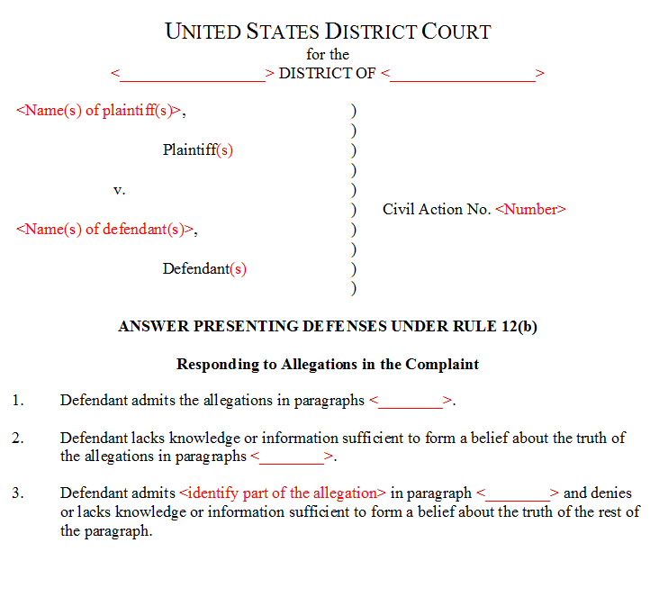

Slide 22
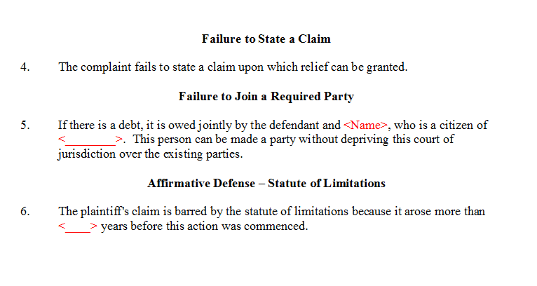

Slide 23
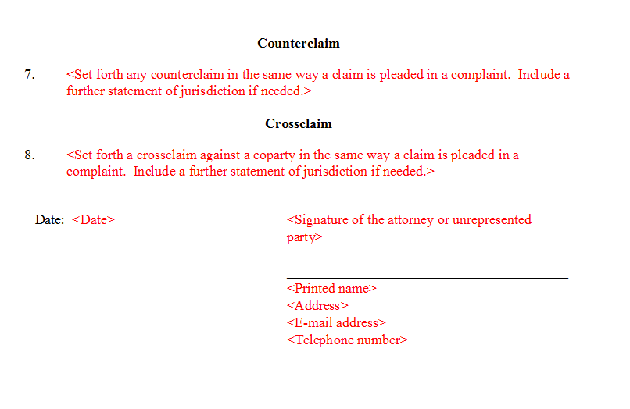

Slide 24
Rule 11. Signing Pleadings, Motions, and Other Papers; Representations to the Court; Sanctions

Slide 25
what is a frivolous action?

Slide 26
an action that loses?

Slide 27
are frivolous cases a problem?

Slide 28
why bring a frivolous action?

Slide 29
(a) Signature. Every pleading, written motion, and other paper must be signed by at least one attorney of record in the attorney’s name — or by a party personally if the party is unrepresented. The paper must state the signer’s address, e-mail address, and telephone number. Unless a rule or statute specifically states otherwise, a pleading need not be verified or accompanied by an affidavit. The court must strike an unsigned paper unless the omission is promptly corrected after being called to the attorney’s or party’s attention.

Slide 30
(b) Representations to the Court. By presenting to the court a pleading, written motion, or other paper — whether by signing, filing, submitting, or later advocating it — an attorney or unrepresented party certifies that to the best of the person’s knowledge, information, and belief, formed after an inquiry reasonable under the circumstances:

Slide 31
Attorney has a good faith belief that the factual allegation has evidentiary support. Is R 11 satisfied?

Slide 32
objective standard

Slide 33
When Attorney signed the complaint it was true that, to the best of her knowledge, information, and belief, formed after an inquiry reasonable under the circumstances the standards in R 11 (b) were satisfied. Is she safe?

Slide 34
continuing duty

Slide 35
(1) it is not being presented for any improper purpose, such as to harass, cause unnecessary delay, or needlessly increase the cost of litigation;

Slide 36
Attorney has a non-frivolous motion to dismiss for lack of personal jurisdiction. She and her client are happy litigating in the court but believes that a successful motion to dismiss would help wear down her opponent.

Slide 37
(2) the claims, defenses, and other legal contentions are warranted by existing law or by a nonfrivolous argument for extending, modifying, or reversing existing law or for establishing new law;

Slide 38
If legal contentions must be warranted by existing law, should the attorneys who argued for the plaintiffs in Brown v. Board of Education have been be sanctioned under R. 11?

Slide 39
Can you always satisfy R. 11(b)(2) simply by saying: “We would like the law to be extended to allow our action”?

Slide 40
Attorney has a non-frivolous arguments for legal contention X, but she has never mentioned it. Can she be sanctioned under R 11(b)(2)?

Slide 41
(3) the factual contentions have evidentiary support or, if specifically so identified, will likely have evidentiary support after a reasonable opportunity for further investigation or discovery; and (4) the denials of factual contentions are warranted on the evidence or, if specifically so identified, are reasonably based on belief or a lack of information.

Slide 42
Can you always satisfy R. 11(b)(3) by saying - “The following allegation is likely to have evidentiary support after a reasonable opportunity for further investigation or discovery”?

Slide 43
Does the evidentiary support have to be admissible at trial?

Slide 44
Can a plaintiff lose at summary judgment and nevertheless have satisfied R11(b)(3) at the pleading stage?

Slide 45
Can a plaintiff defeat a motion for summary judgment and nevertheless have violated R11(b)(3) at the pleading stage?

Slide 46
did the complaint in Twombly/Iqbal satisfy R 11(b)(3)?

Slide 47
(d) Inapplicability to Discovery. This rule does not apply to disclosures and discovery requests, responses, objections, and motions under Rules 26 through 37.

Slide 48
11(c)(2) Motion for Sanctions. A motion for sanctions must be made separately from any other motion and must describe the specific conduct that allegedly violates Rule 11(b). The motion must be served under Rule 5, but it must not be filed or be presented to the court if the challenged paper, claim, defense, contention, or denial is withdrawn or appropriately corrected within 21 days after service or within another time the court sets.

Slide 49
11(c)(1) In General. If, after notice and a reasonable opportunity to respond, the court determines that Rule 11(b) has been violated, the court may impose an appropriate sanction on any attorney, law firm, or party that violated the rule or is responsible for the violation. Absent exceptional circumstances, a law firm must be held jointly responsible for a violation committed by its partner, associate, or employee.

Slide 50
Attorney relies in making a factual allegation upon a document fabricated by Client, but taken by Attorney to be genuine. Can Attorney be sanctioned under R. 11(b)(3)? Can Client be?

Slide 51
11(c)(5) Limitations on Monetary Sanctions. The court must not impose a monetary sanction: (A) against a represented party for violating Rule 11(b)(2)…

Slide 52
Can a court apply R 11 sanctions sua sponte?

Slide 53
11(c)(3) - On the Court’s Initiative. On its own, the court may order an attorney, law firm, or party to show cause why conduct specifically described in the order has not violated Rule 11(b).

Slide 54
R 11(c)(5) Limitations on Monetary Sanctions. The court must not impose a monetary sanction… (B) on its own, unless it issued the show-cause order under Rule 11(c)(3) before voluntary dismissal or settlement of the claims made by or against the party that is, or whose attorneys are, to be sanctioned.

Slide 55
11(c)(4) - A sanction imposed under this rule must be limited to what suffices to deter repetition of the conduct or comparable conduct by others similarly situated. The sanction may include nonmonetary directives; an order to pay a penalty into court; or, if imposed on motion and warranted for effective deterrence, an order directing payment to the movant of part or all of the reasonable attorney’s fees and other expenses directly resulting from the violation.

Slide 56
Can a motion for Rule 11 sanctions be grounds for Rule 11 sanctions?

Slide 57
alternative pleading

Slide 58
R 8(d)(2) Alternative Statements of a Claim or Defense. A party may set out two or more statements of a claim or defense alternatively or hypothetically, either in a single count or defense or in separate ones. If a party makes alternative statements, the pleading is sufficient if any one of them is sufficient.

Slide 59
P sues D alleging that D borrowed P’s vase and returned it cracked. D answers alleging that D never borrowed vase, that vase was cracked when D borrowed it, and that D returned vase uncracked. OK?

Slide 60
(3) Inconsistent Claims or Defenses. A party may state as many separate claims or defenses as it has, regardless of consistency.

Slide 61
Short Essay Question [16 points] P1 (an American subject domiciled in New York) and P2 (a French subject domiciled in France) together wish to sue D (a French subject admitted for permanent residency in the United States and domiciled in Massachusetts) in the Federal District Court for the Northern District of California under French negligence law for a car accident that occurred in France. Briefly describe why there is currently no subject matter jurisdiction, no personal jurisdiction, and no venue for their action. (8 points) Briefly: Could Congress remove these subject matter, personal jurisdiction, and venue impediments such that the action could be brought in the Federal District Court for the Northern District of California and why or why not? (8 points)

