Slide 1
Wed., Oct. 9

Slide 2
ASHCROFT v. IQBAL
556 U.S. 662 (2009)

Slide 3
First, the tenet that a court must accept as true all of the allegations contained in a complaint is inapplicable to legal conclusions. Threadbare recitals of the elements of a cause of action, supported by mere conclusory statements, do not suffice.

Slide 4
Second, only a complaint that states a plausible claim for relief survives a motion to dismiss. Determining whether a complaint states a plausible claim for relief will, as the Court of Appeals observed, be a context-specific task that requires the reviewing court to draw on its judicial experience and common sense. But where the well-pleaded facts do not permit the court to infer more than the mere possibility of misconduct, the complaint has alleged—but it has not “show[n]”—“that the pleader is entitled to relief.” Fed. Rule Civ. Proc. 8(a)(2).

Slide 5
Twombly
Asking for plausible grounds to infer an agreement does not impose a probability requirement at the pleading stage; it simply calls for enough fact to raise a reasonable expectation that discovery will reveal evidence of illegal agreement.

Slide 6
Plaintiff, Joe Smith, by his attorney, alleges as follows:
1. Insurer Corp. is incorporated in Delaware.
2. Insurer Corp. provides term life insurance to hundreds of thousands of individuals in New York, New Jersey, and Connecticut. Joe Smith is Insurer Corp.’s only customer in Florida.
3. Insurer Corp. has sales offices and agents in New York, New Jersey, and Connecticut.
4. Insurer Corp.’s claims processing office, and 2/3 of its employees, are located at 100 1st St., Greenwich, Connecticut, in the District of Connecticut.

Slide 7
5. Around 1/10 of Insurer Corp.’s employees work at an office at 1000 5th Ave., New York, New York, in the Southern District of New York. The Chief Executive Officer and most of the other high-level officers work at this office. The board of directors meets there as well.
6. Jane Jones, an employee of Insurer Corp., lives at 100 North St., Greenwich, Connecticut, in the District of Connecticut.
7. Jane Jones’s office is at the Insurer Corp.’s offices at 1000 5th Ave., New York, New York.
8. Since June 30, 2010, Joe Smith has been living at 10 7th St., Miami, Florida, in the Southern District of Florida.

Slide 8
9. Joe Smith entered into his term life insurance contract with Insurer Corp. at Insurer Corp.’s Greenwich Connecticut office, while he was living in Connecticut. On June 30, 2010, he moved to Miami, Florida and continued to pay his premiums from there.
10. On January 12, 2011, Jane Jones, who was updating Joe Smith’s files, negligently left her laptop computer on a bench outside her office building at 1000 5th Ave., New York, New York.
11. Sensitive financial information concerning Joe Smith, including his Social Security Number and credit card numbers, were negligently left unencrypted on Jane Jones’s laptop.

Slide 9
12 Joe Smith is himself careful with his financial information.
13. Six weeks after the loss of the laptop, Joe Smith was the victim of identity theft, perpetrated by someone as yet unknown, in which a fake credit card was created under his name.
14. Joe Smith’s damages from the identity theft has been $78,000.
15. Joe Smith’s damages were proximately caused by the defendants’ negligence.

Slide 10
There is clearly no TwIqbal problem with the allegations of negligent conduct. The plaintiff does not engage in “a formulaic recitation of the elements of a cause of action.” He describes concrete acts that plausibly constitute negligence – leaving a laptop on a bench outside an office building with sensitive information unencrypted.

Slide 11
The problem is the allegation of causation between the negligent acts and the plaintiff’s damages (from identity theft). One might argue that the allegation of causation suffers from the same problem that the allegation of an agreement did in Twombly. In Twombly the plaintiffs alleged an agreement between the Baby Bells, but at the time they had only parallel conduct as their evidence of an agreement. Since there was an alternative explanation of the parallel conduct besides an agreement (namely, that the Baby Bells each had their own independent economic justifications for engaging in acts they did), the complaint failed to plausibly allege an agreement.

Slide 12
Here the plaintiff alleges causation, but all he has as evidence is that the damages occurred soon after the defendants’ negligent acts. Here too there is an alternative explanation, namely that the plaintiff’s information was obtained from a different source. The plaintiff does allege facts that seek to close off this alternative, however, by saying that he is careful with his information. And we must take this allegation as true for the purposes of judging the sufficiency of the complaint. But even careful people can have their personal information stolen.

Slide 13
responding to a complaint…

Slide 14
default

Slide 15
Virgin Records America, Inc. v. Lacey (S.D. Ala. 2007)

Slide 16
entry of default

Slide 17
motion for a default judgment

Slide 18
- P sues D in federal court in New York
- D appears and argues lack of PJ and SMJ
- D loses and appeals are not pursued
- P then sues on the judgment in state court in CA, where D has assets
- can D challenge the federal judgment for want of SMJ and PJ?

Slide 19
- P sues D in federal court in New York
- D defaults
- P brings a motion for a default judgment
- the court determines whether it has SMJ and PJ before entering the default judgment
- P then sues on the default judgment in state court in CA, where D has assets
- can D challenge the default judgment for want of SMJ and PJ?

Slide 20
- P sues D in federal court in New York
- D appears and does not mention PJ or SMJ (the court doesn’t mention SMJ either)
- D loses and appeals are not pursued
- P then sues on the judgment in state court in CA, where D has assets
- can D challenge the federal judgment for want of SMJ and PJ?

Slide 21
pleadings

Slide 22
FRCP 7. Pleadings Allowed; Form of Motions and Other Papers
(a) Pleadings. Only these pleadings are allowed:
(1) a complaint;
(2) an answer to a complaint;
(3) an answer to a counterclaim designated as a counterclaim;
(4) an answer to a crossclaim;
(5) a third-party complaint;
(6) an answer to a third-party complaint; and
(7) if the court orders one, a reply to an answer.

Slide 23
answers

Slide 24
preanswer motions

Slide 25
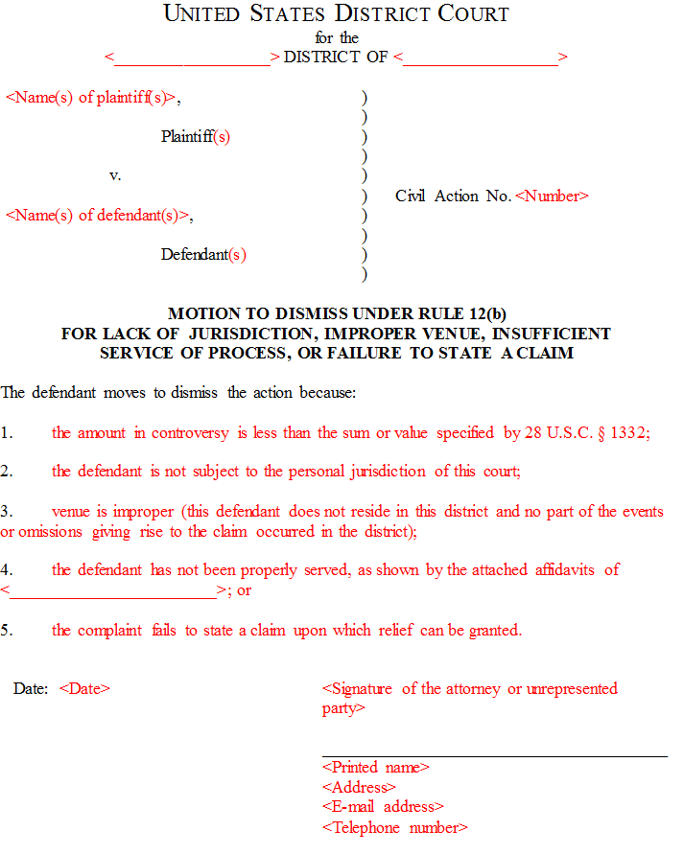

Slide 26
FRCP 12(b) How to Present Defenses. Every defense to a claim for relief in any pleading must be asserted in the responsive pleading if one is required. But a party may assert the following defenses by motion:
(1) lack of subject-matter jurisdiction;
(2) lack of personal jurisdiction;
(3) improper venue;
(4) insufficient process;
(5) insufficient service of process;
(6) failure to state a claim upon which relief can be granted; and
(7) failure to join a party under Rule 19.

Slide 27
FRCP 12(b): “No defense or objection is waived by joining it with one or more other defenses or objections in a responsive pleading or in a motion.”

Slide 28
If, on a motion under Rule 12(b)(6) or 12(c), matters outside the pleadings are presented to and not excluded by the court, the motion must be treated as one for summary judgment under Rule 56. All parties must be given a reasonable opportunity to present all the material that is pertinent to the motion.

Slide 29
FRCP 12(c) Motion for Judgment on the Pleadings.
After the pleadings are closed—but early enough not to delay trial—a party may move for judgment on the pleadings

Slide 30
12(e) Motion for a More Definite Statement. A party may move for a more definite statement of a pleading to which a responsive pleading is allowed but which is so vague or ambiguous that the party cannot reasonably prepare a response. The motion must be made before filing a responsive pleading and must point out the defects complained of and the details desired. If the court orders a more definite statement and the order is not obeyed within 14 days after notice of the order or within the time the court sets, the court may strike the pleading or issue any other appropriate order.

Slide 31
12(f) Motion to Strike. The court may strike from a pleading an insufficient defense or any redundant, immaterial, impertinent, or scandalous matter. The court may act:
(1) on its own; or
(2) on motion made by a party either before responding to the pleading or, if a response is not allowed, within 21 days after being served with the pleading.

Slide 32
timing

Slide 33
FRCP 12(a) Time to Serve a Responsive Pleading.
(1) In General. Unless another time is specified by this rule or a federal statute, the time for serving a responsive pleading is as follows:
(A) A defendant must serve an answer:
(i) within 21 days after being served with the summons and complaint; or
(ii) if it has timely waived service under Rule 4(d), within 60 days after the request for a waiver was sent . . .
(B) A party must serve an answer to a counterclaim or crossclaim within 21 days after being served with the pleading that states the counterclaim or crossclaim.
(C) A party must serve a reply to an answer within 21 days after being served with an order to reply, unless the order specifies a different time.

Slide 34
12(a)(4) Effect of a Motion. Unless the court sets a different time, serving a motion under this rule alters these periods as follows:
(A) if the court denies the motion or postpones its disposition until trial, the responsive pleading must be served within 14 days after notice of the court’s action; or
(B) if the court grants a motion for a more definite statement, the responsive pleading must be served within 14 days after the more definite statement is served.

Slide 35
waiver of defenses

Slide 36
FRCP 12(g) Joining Motions.
(1) Right to Join. A motion under this rule may be joined with any other motion allowed by this rule.
(2) Limitation on Further Motions. Except as provided in Rule 12(h)(2) or (3), a party that makes a motion under this rule must not make another motion under this rule raising a defense or objection that was available to the party but omitted from its earlier motion.
(h) Waiving and Preserving Certain Defenses.
(1) When Some Are Waived. A party waives any defense listed in Rule 12(b)(2)-(5) by:
(A) omitting it from a motion in the circumstances described in Rule 12(g)(2); or
(B) failing to either:
(i) make it by motion under this rule; or
(ii) include it in a responsive pleading or in an amendment allowed by Rule 15(a)(1) as a matter of course.
(2) When to Raise Others. Failure to state a claim upon which relief can be granted, to join a person required by Rule 19(b), or to state a legal defense to a claim may be raised:
(A) in any pleading allowed or ordered under Rule 7(a);
(B) by a motion under Rule 12(c); or
(C) at trial.
(3) Lack of Subject-Matter Jurisdiction. If the court determines at any time that it lacks subject-matter jurisdiction, the court must dismiss the action.

Slide 37
SMJ – can bring up at any time

Slide 38
failure to state claim, failure to join necessary party: if you bring up in a pre-answer motion under R 12, you can’t bring it up in a second pre-answer motion (unless it was not available to you at the time) but you can bring it up in your answer or later

Slide 39
pj, venue, process, service
If you submit a pre-answer motion under R 12, it must be in it – it cannot be brought up in a second pre-answer motion (unless it was not available to you at the time)
If your first response is instead an answer it must be in it (unless you can add it through an amendment “as a matter of course”)

Slide 40
- P serves D in suit for battery
- Within 21 days D makes a motion to dismiss for lack of PJ
- D’s motion is rejected by the court
- May D make another pre-answer motion to dismiss for improper venue?
- May D introduce venue as a defense in his answer?
- May D introduce failure to state a claim in a second pre-answer motion?
- In his answer?
- After the pleading period?
- May D introduce lack of SMJ in a second pre-answer motion?
- In his answer?
- After the pleading period?

Slide 41
P serves D in suit for battery
Within 21 days D answers
May D include with that answer the defense of lack of PJ?
After the answer may D make a motion to dismiss for lack of SMJ?
After the answer, may D ask for a judgment on the pleadings on the ground that P fails to state a claim?
After the answer, may D make a motion to dismiss for insufficient service?
May D save the defense of insufficient service by including it the answer by an amendment under R. 15 “as a matter of course”?

Slide 42
P serves D in suit for battery
Within 21 days D makes a motion for a more definite statement and a motion to dismiss for lack of PJ
The court grants the motion for a more definite statement but denies the motion to dismiss
P responds to the motion for a more definite statement, serving D with an amended complaint
D makes a motion to dismiss for failure to state a claim and a motion to dismiss for insufficient service

Slide 43
Hunter v. Serv-Tech Inc. (E.D. La. 2009)

Slide 44
answers

Slide 45
defenses in an answer
1) PJ, SMJ, venue, service, process
2) failure to state a claim
3) negative defenses
4) affirmative defenses

Slide 46
FRCP 8(b) Defenses; Admissions and Denials.
(1) In General. In responding to a pleading, a party must:
(A) state in short and plain terms its defenses to each claim asserted against it; and
(B) admit or deny the allegations asserted against it by an opposing party.

Slide 47
FRCP 8(c) Affirmative Defenses.
(1) In General. In responding to a pleading, a party must affirmatively state any avoidance or affirmative defense, including:
• accord and satisfaction;
• arbitration and award;
• assumption of risk;
• contributory negligence;
• discharge in bankruptcy;
• duress;
• estoppel;
• failure of consideration;
• fraud;
• illegality;
• injury by fellow servant;
• laches;
• license;
• payment;
• release;
• res judicata;
• statute of frauds;
• statute of limitations; and
• waiver.

Slide 48
8(c)(2) Mistaken Designation. If a party mistakenly designates a defense as a counterclaim, or a counterclaim as a defense, the court must, if justice requires, treat the pleading as though it were correctly designated, and may impose terms for doing so.

Slide 49
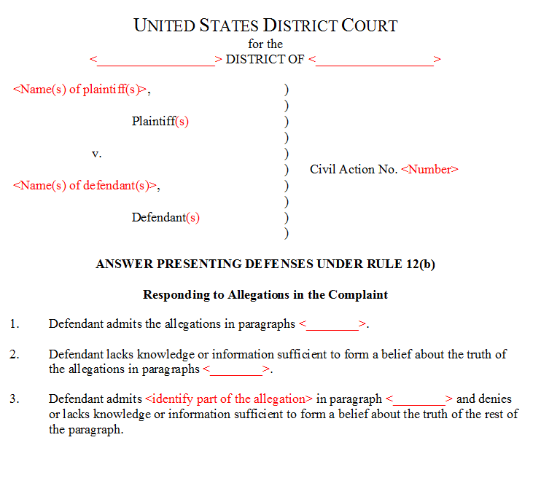

Slide 50
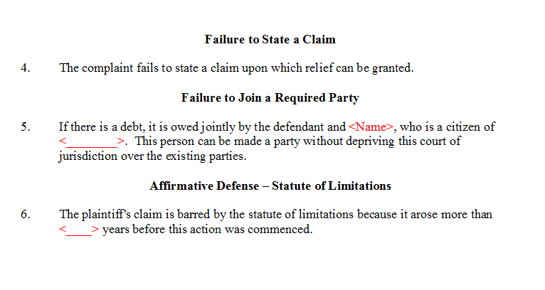

Slide 51
