Slide 1
Mon., Oct. 7

Slide 2
venue in federal court

Slide 3
Sec. 1391. - Venue generally
(b) Venue in general.--A civil action may be brought in--
(1) a judicial district in which any defendant resides, if all defendants are residents of the State in which the district is located;
(2) a judicial district in which a substantial part of the events or omissions giving rise to the claim occurred, or a substantial part of property that is the subject of the action is situated;

Slide 4
(c) Residency.--For all venue purposes--
(1) a natural person, including an alien lawfully admitted for permanent residence in the United States, shall be deemed to reside in the judicial district in which that person is domiciled;

Slide 5
1391(c)(3) a defendant not resident in the United States may be sued in any judicial district, and the joinder of such a defendant shall be disregarded in determining where the action may be brought with respect to other defendants.

Slide 6
Residence of corporations and unincorporated associations:
§ 1391(c)(2) an entity with the capacity to sue and be sued in its common name under applicable law, whether or not incorporated, shall be deemed to reside, if a defendant, in any judicial district in which such defendant is subject to the court's personal jurisdiction with respect to the civil action in question

Slide 7
(d) Residency of corporations in States with multiple districts.--For purposes of venue under this chapter, in a State which has more than one judicial district and in which a defendant that is a corporation is subject to personal jurisdiction at the time an action is commenced, such corporation shall be deemed to reside in any district in that State within which its contacts would be sufficient to subject it to personal jurisdiction if that district were a separate State, and, if there is no such district, the corporation shall be deemed to reside in the district within which it has the most significant contacts.

Slide 8
1391(b)(3) if there is no district in which an action may otherwise be brought as provided in this section, any judicial district in which any defendant is subject to the court's personal jurisdiction with respect to such action.

Slide 9
dismissal for improper venue

Slide 10
transfer from a district without venue to one with venue

Slide 11
28 U.S.C. § 1406. CURE OR WAIVER OF DEFECTS
(a) The district court of a district in which is filed a case laying venue in the wrong division or district shall dismiss, or if it be in the interest of justice, transfer such case to any district or division in which it could have been brought.

Slide 12
waiver of the defense of venue

Slide 13
transfer from a district with venue to a more convenient one with venue

Slide 14
28 U.S.C. § 1404. CHANGE OF VENUE
(a) For the convenience of parties and witnesses, in the interest of justice, a district court may transfer any civil action to any other district or division where it might have been brought or to any district or division to which all parties have consented.

Slide 15
dismissal from a district with venue so that it can be brought outside of the United States

Slide 16
forum non conveniens

Slide 17
MACMUNN v. ELI LILLY CO.
559 F. Supp. 2d 58 (D.D.C. 2008)

Slide 18
As to the second showing, the statute calls on the court to weigh a number of case-specific private and public-interest factors. The private-interest considerations include: (1) the plaintiff’s choice of forum, unless the balance of convenience is strongly in favor of the defendants; (2) the defendant’s choice of forum; (3) whether the claim arose elsewhere; (4) the convenience of the parties; (5) the convenience of the witnesses; and (6) the ease of access to sources of proof. The public-interest considerations include: (1) the transferee’s familiarity with the governing laws; (2) the relative congestion of the calendars of the potential transferee and transferor courts; and (3) the local interest in deciding local controversies at home.

Slide 19
shouldn’t the transfer lead to dismissal on statute of limitations grounds?

Slide 20
Van Dusen v. Barrack, 376 U.S. 612 (1964)

Slide 21
forum selection clauses

Slide 22
drafting a complaint

Slide 23
Rule 10. Form of Pleadings
Caption; Names of Parties. Every pleading must have a caption with the court’s name, a title, a file number, and a Rule 7(a) designation. The title of the complaint must name all the parties; the title of other pleadings, after naming the first party on each side, may refer generally to other parties.

Slide 24
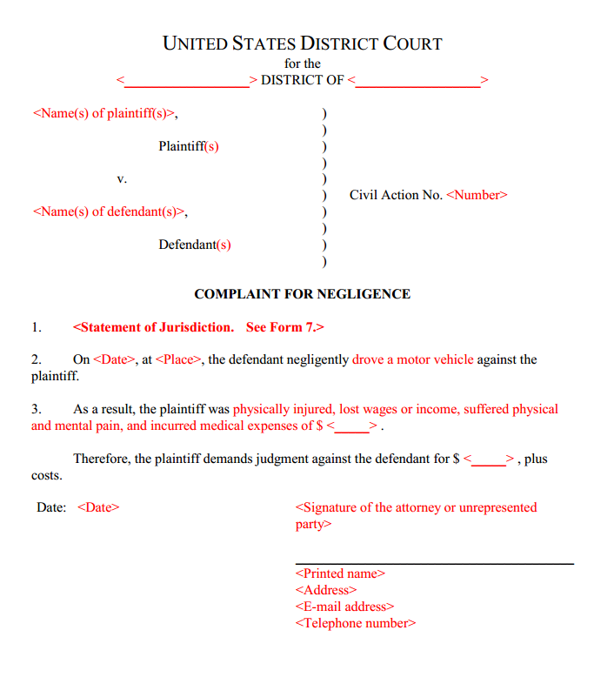

Slide 25
- Rule 8. General Rules of Pleading
(a) Claim for Relief. A pleading that states a claim for relief must contain:
(1) a short and plain statement of the grounds for the court’s jurisdiction, unless the court already has jurisdiction and the claim needs no new jurisdictional support;
(2) a short and plain statement of the claim showing that the pleader is entitled to relief; and
(3) a demand for the relief sought, which may include relief in the alternative or different types of relief.

Slide 26
Rule 10(b)
Paragraphs; Separate Statements. A party must state its claims or defenses in numbered paragraphs, each limited as far as practicable to a single set of circumstances. A later pleading may refer by number to a paragraph in an earlier pleading. If doing so would promote clarity, each claim founded on a separate transaction or occurrence — and each defense other than a denial — must be stated in a separate count or defense.

Slide 27
what purposes does a complaint serve?

Slide 28
what purpose does service of a complaint on the defendant serve?

Slide 29
what purpose does the answer to a complaint serve?

Slide 30
what role might the complaint with answer play in: discovery? trial?

Slide 31
how might a defendant point to what is in a complaint to weed out an action that should not proceed to discovery/trial?

Slide 32
wrong forum

Slide 33
failure to state a claim

Slide 34
frivolousness – inadequate evidentiary support

Slide 35
balancing…
- accuracy
- efficiency
- autonomy

Slide 36
is there any way to dismiss on the basis of inadequate evidentiary support at the pleading stage?

Slide 37
how do the federal rules take care of frivolous factual allegations?

Slide 38
FRCP 11
FRCP 56 (summary judgment)

Slide 39
history of pleading

Slide 40
1) common law pleading/equity pleading
2) reform through Field Code
- called “fact” or “code” pleading

Slide 41
code pleading – no “conclusory allegations”
- ultimate facts (no evidence or conclusions of law)

Slide 42
D negligently drove…

Slide 43
code pleading – state each cause of action separately

Slide 44
modern approach: notice pleading

Slide 45
- Rule 8. General Rules of Pleading
(a) Claim for Relief. A pleading that states a claim for relief must contain:
…
(2) a short and plain statement of the claim showing that the pleader is entitled to relief;
…

Slide 46
can you be conclusory in your pleading under 8(a)?

Slide 48
focus is on a claim (a transaction) – need not specify the cause of action

Slide 49
three things that can be wrong with the factual allegations in a complaint:
1) legal insufficiency
2) inadequate specificity (even to satisfy 8(a)(2))
3) lack of evidentiary support to justify discovery/trial

Slide 50
1 legal sufficiency of factual allegations do they state a claim?

Slide 51
how does the D bring up the problem of legal insufficiency?

Slide 52
motion to dismiss for failure to state a claim/defense of failure to state a claim in one’s answer leave to amend

Slide 53
FRCP 12(b) How to Present Defenses. Every defense to a claim for relief in any pleading must be asserted in the responsive pleading if one is required. But a party may assert the following defenses by motion:
(1) lack of subject-matter jurisdiction;
(2) lack of personal jurisdiction;
(3) improper venue;
(4) insufficient process;
(5) insufficient service of process;
(6) failure to state a claim upon which relief can be granted; and
(7) failure to join a party under Rule 19.
...

Slide 54
2 level of specificity in factual allegations are the factual allegations in the complaint specific enough?

Slide 55
- Rule 8. General Rules of Pleading
(a) Claim for Relief. A pleading that states a claim for relief must contain:
...(2) a short and plain statement of the claim showing that the pleader is entitled to relief...

Slide 56
how does the D bring up the problem of lack of specificity?

Slide 57
FRCP 12(e) Motion for a More Definite Statement. A party may move for a more definite statement of a pleading to which a responsive pleading is allowed but which is so vague or ambiguous that the party cannot reasonably prepare a response. The motion must be made before filing a responsive pleading and must point out the defects complained of and the details desired. If the court orders a more definite statement and the order is not obeyed within 14 days after notice of the order or within the time the court sets, the court may strike the pleading or issue any other appropriate order.

Slide 58
3 evidentiary support for factual allegations

Slide 59
how is this problem addressed?

Slide 60
Rule 11. Signing Pleadings, Motions, and Other Papers; Representations to the Court; Sanctions
...(b) Representations to the Court. By presenting to the court a pleading, written motion, or other paper — whether by signing, filing, submitting, or later advocating it — an attorney or unrepresented party certifies that to the best of the person’s knowledge, information, and belief, formed after an inquiry reasonable under the circumstances:
...(3) the factual contentions have evidentiary support or, if specifically so identified, will likely have evidentiary support after a reasonable opportunity for further investigation or discovery; ...

Slide 61
Rule 56. Summary Judgment
(a) Motion for Summary Judgment or Partial Summary Judgment. A party may move for summary judgment, identifying each claim or defense — or the part of each claim or defense — on which summary judgment is sought. The court shall grant summary judgment if the movant shows that there is no genuine dispute as to any material fact and the movant is entitled to judgment as a matter of law. The court should state on the record the reasons for granting or denying the motion. ...

Slide 62
can detail in a complaint be used to weed out frivolous actions?

Slide 63
what problems exist with these factual allegations…?

Slide 64
Defendant Josh Kindle intentionally engaged in contact with the person of Plaintiff Michael Green that was harmful or offensive, causing damages.

Slide 65
On Wednesday, September 26, 2018 at 2:41 p.m., Defendant Josh Kindle intentionally failed to praise Plaintiff Michael Green for Plaintiff’s exemplary lecture on civil procedure, in circumstances in which praise would have been reasonable, thereby causing Plaintiff substantial psychological distress.

Slide 66
Over the period of June 30, 2016 to September 26, 2017 Defendant Josh Kindle operated a moon base which emitted mind rays directed at Plaintiff Michael Green, allowing Defendant to read Plaintiff’s thoughts and causing Plaintiff to experience severe headaches and ringing in the ears.

Slide 67
can the mind ray complaint be dismissed at the pleading stage?

Slide 68
why can’t you always get to discovery then?

Slide 69
why have this system?

Slide 70
balancing… accuracy efficiency autonomy

Slide 71
distinguish between these two types of criticisms concerning the specificity of factual allegations in plaintiff’s complaint

Slide 72
1
- D is not claiming that the P does not have evidentiary support for the allegations
- D is worried that what is alleged does not add up to a violation of the law (some element of a cause of action looks like it is missing) but it is difficult to tell because the P is not that specific

Slide 73
assume that under the relevant law there is no strict liability for product defects, only negligence liability
P alleges that D manufactured the product “improperly”

Slide 74
Conley v. Gibson, 355 U.S. 41 (1957)

Slide 75
Conley v. Gibson
“complaint should not be dismissed for failure to state a claim unless it appears beyond doubt that the plaintiff can prove no set of facts in support of his claim which would entitle him to relief”

Slide 76
2
- D thinks P does not have evidentiary support for the allegations
- all the elements are there but the D thinks that P will not be able to prove an element (that is why the P lacks specificity)

Slide 77
assume that under the relevant law there is no strict liability for product defects, only negligence liability
P alleges that D manufactured the product “negligently” without saying how it was negligent

Slide 78
Dioguardi v. Durning (2d Cir. 1944)

Slide 79
how generous should we be in reading a complaint under Conley?

Slide 80
inconsistent pleading

Slide 81
Rule 8. General Rules of Pleading
...
(d) Pleading to Be Concise and Direct; Alternative Statements; Inconsistency.
(1) In General. Each allegation must be simple, concise, and direct. No technical form is required.
(2) Alternative Statements of a Claim or Defense. A party may set out two or more statements of a claim or defense alternatively or hypothetically, either in a single count or defense or in separate ones. If a party makes alternative statements, the pleading is sufficient if any one of them is sufficient.
(3) Inconsistent Claims or Defenses. A party may state as many separate claims or defenses as it has, regardless of consistency.

Slide 82
Doe v. Smith (7th Cir. 2005)

Slide 83
what happened in the trial court?

Slide 84
federal wiretapping statute
18 U.S.C. §§ 2510-22

Slide 85
any person who
“intentionally intercepts…any wire, oral, or electronic communication”
§ 2511(1)(a)

Slide 86
did he capture (set aside intercept) a “wire, oral, or electronic communication”?

Slide 87
“oral communication” means any oral communication uttered by a person exhibiting an expectation that such communication is not subject to interception under circumstances justifying such expectation…

Slide 88
“intercept” means “the aural or other acquisition of the contents of any wire, electronic, or oral communication through the use of any electronic, mechanical, or other device”
18 U.S.C. § 2510(4)

Slide 89
and
(c) intentionally discloses…to any other person the contents of any wire, oral, or electronic communication, knowing or having reason to know that the information was obtained through the interception of a wire, oral, or electronic communication in violation of this subsection; ․․ shall be subject to suit as provided in subsection (5)

Slide 90
liability generally requires proof that the interception or disclosure occurred in or through the means of interstate commerce

Slide 91
do we now know that she states a claim?

