Slide 1
Wed., Oct. 17

Slide 2
venue in federal court

Slide 3
Sec. 1391. - Venue generally (b) Venue in general.--A civil action may be brought in-- (1) a judicial district in which any defendant resides, if all defendants are residents of the State in which the district is located; (2) a judicial district in which a substantial part of the events or omissions giving rise to the claim occurred, or a substantial part of property that is the subject of the action is situated;

Slide 4
(c) Residency.--For all venue purposes-- (1) a natural person, including an alien lawfully admitted for permanent residence in the United States, shall be deemed to reside in the judicial district in which that person is domiciled;

Slide 5
1391(c)(3) a defendant not resident in the United States may be sued in any judicial district, and the joinder of such a defendant shall be disregarded in determining where the action may be brought with respect to other defendants.

Slide 6
Residence of corporations and unincorporated associations: § 1391(c)(2) an entity with the capacity to sue and be sued in its common name under applicable law, whether or not incorporated, shall be deemed to reside, if a defendant, in any judicial district in which such defendant is subject to the court's personal jurisdiction with respect to the civil action in question

Slide 7
(d) Residency of corporations in States with multiple districts.--For purposes of venue under this chapter, in a State which has more than one judicial district and in which a defendant that is a corporation is subject to personal jurisdiction at the time an action is commenced, such corporation shall be deemed to reside in any district in that State within which its contacts would be sufficient to subject it to personal jurisdiction if that district were a separate State, and, if there is no such district, the corporation shall be deemed to reside in the district within which it has the most significant contacts.

Slide 8
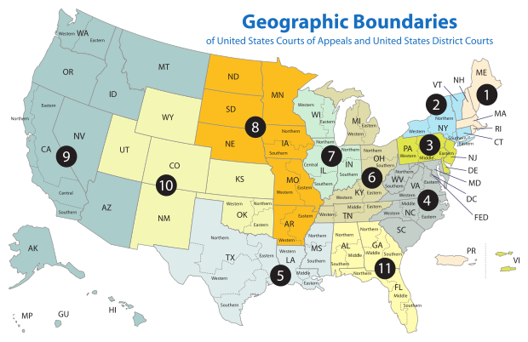
P (S.F. – N.D. Cal.) sues the D1 Corp. & the D2 Corp. Suit is a Cal. state law breach of contract action concerning a contract signed in San Francisco for the construction of a hospital in Albany (N.D.N.Y.) D1 Corp. built foundation; D2 Corp. built structure D1 Corp. incorporated in Delaware (D. Del.); main office in NYC (S.D.N.Y.); large branch office in Philadelphia (E.D. Pa.) D2 Corp. incorporated in Delaware (D. Del.); main office in Pittsburgh (W.D. Pa.); large branch office in Boston (D. Mass.)

Slide 9
1391(b)(3) if there is no district in which an action may otherwise be brought as provided in this section, any judicial district in which any defendant is subject to the court's personal jurisdiction with respect to such action.

Slide 10
P (S.F. – N.D. Cal.) sues the D1 (S.D.N.Y) & D2 (E.D. Pa) Suit is breach of contract action concerning a contract signed in San Francisco for the construction of a hospital in Paris D1 built foundation; D2 built structure

Slide 11
P (S.F. – N.D. Cal.) sues the D1 (S.D.N.Y) & D2 (E.D. Pa) Suit is breach of contract action concerning a contract signed in London for the construction of a hospital in Paris D1 built foundation; D2 built structure

Slide 12
venue and removal

Slide 13
assume that in World-Wide Volkswagen the action had been originally been brought in federal court in the E.D. Okla. (where the accident occurred) set aside PJ and SMJ is there venue?

Slide 14
Uffner v. La Reunion Francaise (1st Cir. 2001)

Slide 15
D’s defenses?

Slide 16
what does district court do?

Slide 17
SMJ?

Slide 18
PJ?

Slide 19
venue?

Slide 20
Sec. 1391. - Venue generally (b) Venue in general.--A civil action may be brought in-- (2) a judicial district in which a substantial part of the events or omissions giving rise to the claim occurred, or a substantial part of property that is the subject of the action is situated;

Slide 21
but-for test v. evidence test

Slide 22
is PR a convenient forum?

Slide 23
what if there is no venue in the district…?

Slide 24
dismissal for improper venue

Slide 25
transfer from a district without venue to one with venue

Slide 26
transfer occurs only within a court system

Slide 27
28 U.S.C. § 1406. CURE OR WAIVER OF DEFECTS (a) The district court of a district in which is filed a case laying venue in the wrong division or district shall dismiss, or if it be in the interest of justice, transfer such case to any district or division in which it could have been brought.

Slide 28
waiver of the defense of venue

Slide 29
may a court bring up lack of venue sua sponte?

Slide 30
what if there is venue in the district but there is a better district that also has venue?

Slide 31
transfer from a district with venue to a more convenient one with venue

Slide 32
28 U.S.C. § 1404. CHANGE OF VENUE (a) For the convenience of parties and witnesses, in the interest of justice, a district court may transfer any civil action to any other district or division where it might have been brought or to any district or division to which all parties have consented.

Slide 33
what if there is venue in the district but the best place for the action to be brought is outside the USD?

Slide 34
forum non conveniens

Slide 35
transfer under 1404

Slide 36
MACMUNN v. ELI LILLY CO. 559 F. Supp. 2d 58 (D.D.C. 2008)

Slide 37
why did the plaintiff choose DC?

Slide 38
why is removal possible?

Slide 39
why is there venue in D.D.C.?

Slide 40
why was there PJ in DC?

Slide 41
two questions concerning transfer under 1404 1) could the action have been brought in D. Mass.? 2) do considerations of convenience and the interests of justice weigh in favor of transfer?

Slide 42
As to the second showing, the statute calls on the court to weigh a number of case-specific private and public-interest factors. The private-interest considerations include: (1) the plaintiff’s choice of forum, unless the balance of convenience is strongly in favor of the defendants; (2) the defendant’s choice of forum; (3) whether the claim arose elsewhere; (4) the convenience of the parties; (5) the convenience of the witnesses; and (6) the ease of access to sources of proof. The public-interest considerations include: (1) the transferee’s familiarity with the governing laws; (2) the relative congestion of the calendars of the potential transferee and transferor courts; and (3) the local interest in deciding local controversies at home.

Slide 43
shouldn’t the transfer lead to dismissal on statute of limitations grounds?

Slide 44
Van Dusen v. Barrack, 376 U.S. 612 (1964)

Slide 45
forum selection clauses

Slide 46
imagine that a contract between the Ps and D said that the Ps’ claim had to be litigated in Wyoming what would the D argue to get the case dismissed/transferred? how would the court decide?

