Slide 1
Thurs., Aug. 31

Slide 2
federal subject matter jurisdiction federal question (or “arising under”) jurisdiction

Slide 3
U.S. Const. Article III. Section. 2. The judicial Power shall extend to all Cases, in Law and Equity, arising under this Constitution, the Laws of the United States, and Treaties made, or which shall be made, under their Authority…

Slide 4
constitutional scope of arising under jurisdiction federal law forms an ingredient

Slide 5
28 U.S.C. § 1331. - Federal question The district courts shall have original jurisdiction of all civil actions arising under the Constitution, laws, or treaties of the United States.

Slide 6
well-pleaded complaint rule what is the bare minimum that the plaintiff must show to get relief that is what determines SMJ under 1331

Slide 7
what if the Mottleys had brought a declaratory judgment action to determine whether the federal statute overrode their contract and if it did whether it was a taking in violation of the Fifth Amendment? SMJ under 1331? How about if the Railroad had brought the declaratory judgment action?

Slide 8
do not worry about counterclaims here - they cannot be a basis for federal question or diversity jurisdiction but we will deal with the details when we discuss counterclaims

Slide 9
one reading of the well-pleaded complaint rule Holmes’s “creation test” there is SMJ under 1331 if federal law creates the P’s cause of action

Slide 10
P sues D to enjoin D from using a process protected by his patent SMJ under 1331 using creation test?

Slide 11
P and D sign a contract licensing D to use P’s patent for a fee D uses the patent but doesn’t pay the fee P sues D for the fee SMJ under 1331 using creation test?

Slide 12
problem: what if a well-pleaded complaint must refer to both federal and state law?

Slide 13
may knock out a case that satisfies the creation test

Slide 14
even though federal law creates the cause of action, the federal statute may completely incorporate state law standards can mean no smj

Slide 15
Shoshone Mining (US 1900) a federal statute created a cause of action to determine mining rights (without specifying whether the action can be brought only in federal, in federal and state, or only in state court) the cause of action used local mining customs and statutes no federal question smj

Slide 16
very, very rare

Slide 17
what if a well-pleaded complaint must refer to both federal and state law…? may bring in a case that fails to satisfy the creation test

Slide 18
I am a beneficiary of a trust and sue the trustee (under state law) because he has invested in illegal securities in violation of the trust the securities are illegal because they are in violation of federal law SMJ under 1331 using the creation test? similar to Smith v. Kansas City Title & Trust Co. (US 1921)

Slide 19
Gunn v. Minton (US 2013)

Slide 20
28 U.S. Code § 1338 – (a) The district courts shall have original jurisdiction of any civil action arising under any Act of Congress relating to patents... No State court shall have jurisdiction over any claim for relief arising under any Act of Congress relating to patents...

Slide 21
what jurisdiction created Minton’s cause of action?

Slide 22
what does Minton have to show in a well-pleaded complaint to establish relief?

Slide 23
“Does the state-law claim necessarily raise a stated federal issue, actually disputed and substantial, which a federal forum may entertain without disturbing any congressionally approved balance of federal and state judicial responsibilities?” Grable & Sons Metal Products, Inc. v. Darue Engineering & Mfg., (US 2005)

Slide 24
does Minton’s state law claim necessarily raise a federal issue?

Slide 25
is the federal issue actually disputed?

Slide 26
is the federal issue substantial?

Slide 27
“[I]t is not enough that the federal issue be significant to the particular parties in the immediate suit… The substantiality inquiry under Grable looks instead to the importance of the issue to the federal system as a whole.”

Slide 28
would requiring a federal forum to entertain the case disturb any congressionally approved balance of federal and state judicial responsibilities?

Slide 29
does it matter to the case that cases arising under patent law have exclusive federal SMJ?

Slide 30
the LMRA completely preempts state contract law concerning collective bargaining agreements between unions and employers and replaces the whole area of state law with federal law union sues employer under state contract law in state court employer removes on ground that the cause of action is really federal arising under SMJ?

Slide 31
P sues a municipality in federal court for damages under 42 U.S.C. § 1983 for violations of his civil rights the US SCt has never decided whether a municipality can be sued under § 1983 the federal court concludes that municipalities cannot be sued under § 1983 how is the case dismissed: lack of SMJ or failure to state a claim?

Slide 32
P and D get into a fight P wants to sue D in federal court so P sues D for violating federal securities law by hitting him in the face failure to state a claim or lack of SMJ?

Slide 33
P (NY) sues D (NY), a state officer, in federal court for violating his federal civil rights in the course of an arrest P joins a state-law battery action against the officer is this a Smith/Grable/Gunn type case?

Slide 34
removal

Slide 35
transfer distinguished

Slide 36
1441(a) Except as otherwise expressly provided by Act of Congress, any civil action brought in a State court of which the district courts of the United States have original jurisdiction, may be removed by the defendant or the defendants, to the district court of the United States for the district and division embracing the place where such action is pending.

Slide 37
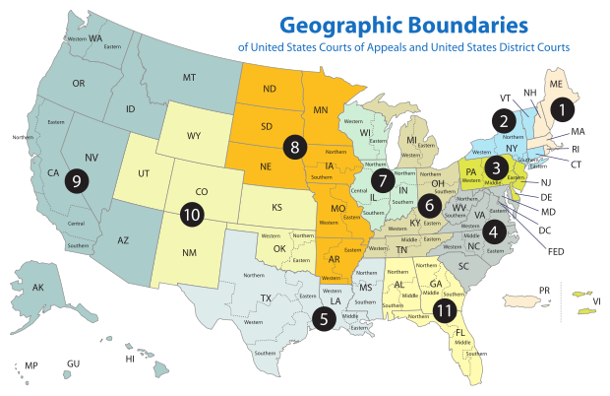

Slide 38
A (Cal.) sues B (NY) and C (Cal) for battery in state court in Nevada Can B and C remove Can only B remove?

Slide 39
A (Nev.) sues B (Cal.) and C (Oreg.) in California state court for battery A asks for $80k each from B and C May B and C remove?

Slide 40
1441(b)(2) A civil action otherwise removable solely on the basis of the jurisdiction under section 1332(a) of this title may not be removed if any of the parties in interest properly joined and served as defendants is a citizen of the State in which such action is brought.

Slide 41
A (Cal.) sues B (NY) and C (NJ) for battery A asks B for more than 75K but C for only 20K May the case be successfully removed by B and C?

Slide 42
P (NY) brings an action against D (NJ) in NY state court for loss of his hand in a car accident P asks for $70k May D remove?

Slide 43
1446(c)(2) If removal of a civil action is sought on the basis of the jurisdiction conferred by section 1332(a), the sum demanded in good faith in the initial pleading shall be deemed to be the amount in controversy, except that- (A) the notice of removal may assert the amount in controversy if the initial pleading seeks-- (i) nonmonetary relief; or (ii) a money judgment, but the State practice either does not permit demand for a specific sum or permits recovery of damages in excess of the amount demanded; and (B) removal of the action is proper on the basis of an amount in controversy asserted under subparagraph (A) if the district court finds, by the preponderance of the evidence, that the amount in controversy exceeds the amount specified in section 1332(a).

