Slide 1
Mon., Oct. 9

Slide 2
responding to a complaint…

Slide 3
default

Slide 4
preanswer motions

Slide 5
timing

Slide 6
waiver of defenses

Slide 7
SMJ – can bring up at any time

Slide 8
failure to state claim, failure to join necessary party: if you bring up in a pre-answer motion under R 12, you can’t bring it up in a second pre-answer motion (unless it was not available to you at the time) but you can bring it up in your answer or later

Slide 9
pj, venue, process, service If you submit a pre-answer motion under R 12, it must be in it – it cannot be brought up in a second pre-answer motion (unless it was not available to you at the time) If your first response is instead an answer it must be in it (unless you can add it through an amendment “as a matter of course”)

Slide 10
answers

Slide 11
defenses in an answer 1) PJ, SMJ, venue, service, process 2) failure to state a claim 3) negative defenses 4) affirmative defenses

Slide 12
FRCP 8(b) Defenses; Admissions and Denials. (1) In General. In responding to a pleading, a party must: (A) state in short and plain terms its defenses to each claim asserted against it; and (B) admit or deny the allegations asserted against it by an opposing party.

Slide 13
FRCP 8(c) Affirmative Defenses. (1) In General. In responding to a pleading, a party must affirmatively state any avoidance or affirmative defense, including: • accord and satisfaction; • arbitration and award; • assumption of risk; • contributory negligence; • discharge in bankruptcy; • duress; • estoppel; • failure of consideration; • fraud; • illegality; • injury by fellow servant; • laches; • license; • payment; • release; • res judicata; • statute of frauds; • statute of limitations; and • waiver.

Slide 14
P (NY) sues D (Ill) in federal court in Illinois under Illinois negligence law under Illinois negligence law, the plaintiff must plead and prove his own lack of contributory negligence in order to state a claim does FRCP 8(c) make a difference to that?

Slide 15
8(c)(2) Mistaken Designation. If a party mistakenly designates a defense as a counterclaim, or a counterclaim as a defense, the court must, if justice requires, treat the pleading as though it were correctly designated, and may impose terms for doing so.

Slide 16
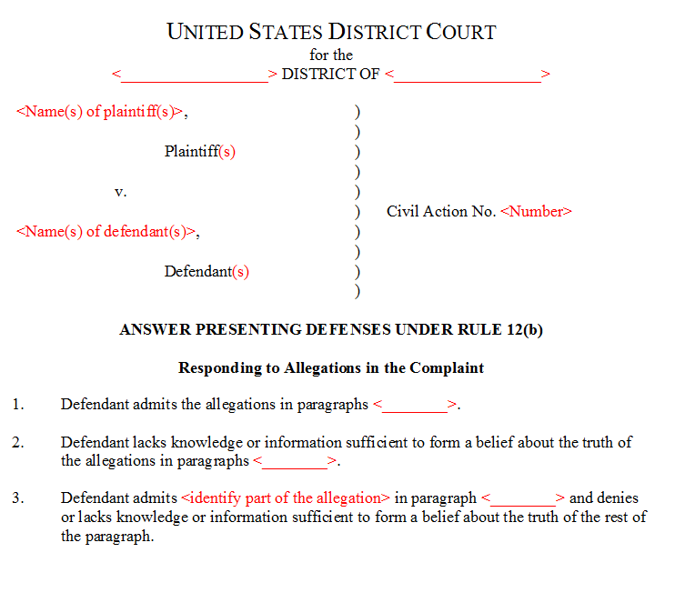

Slide 17
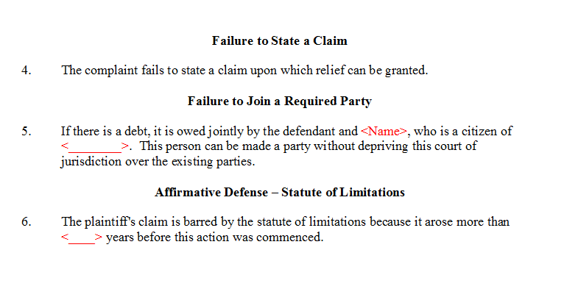

Slide 18
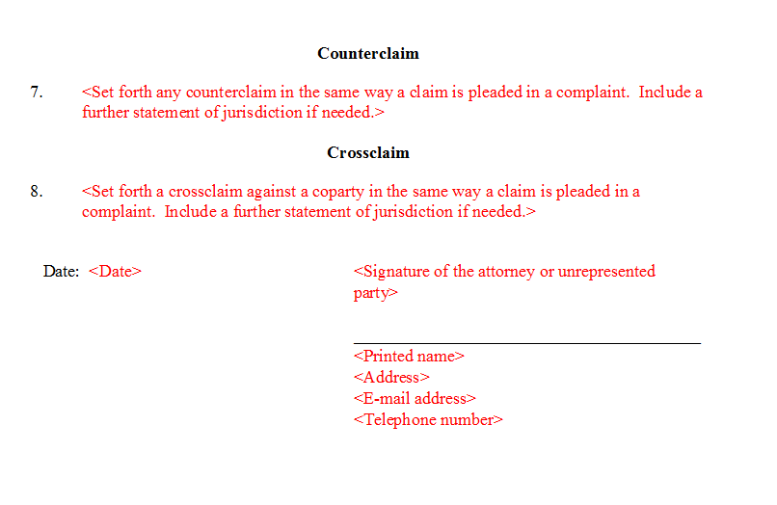

Slide 19
Reis Robotics USA, Inc. v. Concept Industries, Inc. (N.D. Ill. 2006)

Slide 20
motion to strike affirmative defenses

Slide 21
Concept's first affirmative defense is nothing more than a recitation of the standard for a motion to dismiss under Rule 12(b)(6). As alleged, the defense provides no explanation as to how and in what portion of the complaint Reis has failed to state a claim.

Slide 22
is failure to state a claim an affirmative defense?

Slide 23
On Wednesday, September 27, 2017 at 2:41 p.m., Defendant Jefferson Hunt intentionally failed to praise Plaintiff Michael Green for Plaintiff’s exemplary lecture on civil procedure, in circumstances in which praise would have been reasonable, thereby causing Plaintiff substantial psychological distress.

Slide 24
As its second affirmative defense Concept states: “Reis breached the contract on which it purports to rely, and that contract may be void for fraud and/or failure of consideration.”

Slide 25
As its third affirmative defense, Concept alleges: “Reis's payment claims for the silencer fixture are barred because Concept never authorized Reis to begin manufacturing the fixture, as Reis itself has acknowledged.”

Slide 26
Concept's fifth affirmative defense states: “Reis's claims are barred or limited by laches, waiver, estoppel, unclean hands, or similar legal or equitable doctrines.”

Slide 27
Concept's sixth affirmative defense states: “Concept reserves the right to add additional affirmative defenses as they become known through discovery.”

Slide 28
motion to strike admissions/denials

Slide 29
“To the extent the alleged ‘contract’ created by issuance of this purchase order failed to warrant the trim speed and cycle time that Concept required, it was procured by fraud and was of no validity; accordingly, the remaining allegations in this paragraph are denied as true.”

Slide 30
P alleges that D was negligent D answers – “to the extent that the plaintiff was contributorily negligent this is denied”

Slide 31
what is an affirmative defense?

Slide 32
Ingraham v. United States (5th Cir. 1987)

Slide 33
Tex.Rev.Civ.Stat.Ann. art. 4590i, § 11.02(a), In an action on a health care liability claim where final judgment is rendered against a physician or health care provider, the limit of civil liability for damages of the physician or health care provider shall be limited to an amount not to exceed $500,000. (b) Subsection (a) of this section does not apply to the amount of damages awarded on a health care liability claim for the expenses of necessary medical, hospital, and custodial care received before judgment or required in the future for treatment of the injury.

Slide 34
assume the Texas rule is part of the cause of action what would the D be arguing then?

Slide 35
Rule 11. Signing Pleadings, Motions, and Other Papers; Representations to the Court; Sanctions

Slide 36
are frivolous cases a problem?

Slide 37
(a) Signature. Every pleading, written motion, and other paper must be signed by at least one attorney of record in the attorney’s name — or by a party personally if the party is unrepresented. The paper must state the signer’s address, e-mail address, and telephone number. Unless a rule or statute specifically states otherwise, a pleading need not be verified or accompanied by an affidavit. The court must strike an unsigned paper unless the omission is promptly corrected after being called to the attorney’s or party’s attention.

Slide 38
(b) Representations to the Court. By presenting to the court a pleading, written motion, or other paper — whether by signing, filing, submitting, or later advocating it — an attorney or unrepresented party certifies that to the best of the person’s knowledge, information, and belief, formed after an inquiry reasonable under the circumstances:

Slide 39
objective standard

Slide 40
continuing duty

Slide 41
(1) it is not being presented for any improper purpose, such as to harass, cause unnecessary delay, or needlessly increase the cost of litigation;

Slide 42
(2) the claims, defenses, and other legal contentions are warranted by existing law or by a nonfrivolous [good faith] argument for extending, modifying, or reversing existing law or for establishing new law;

Slide 43
(3) the factual contentions have evidentiary support or, if specifically so identified, will likely have evidentiary support after a reasonable opportunity for further investigation or discovery; and (4) the denials of factual contentions are warranted on the evidence or, if specifically so identified, are reasonably based on belief or a lack of information.

Slide 44
(d) Inapplicability to Discovery. This rule does not apply to disclosures and discovery requests, responses, objections, and motions under Rules 26 through 37.

Slide 45
11(c)(2) Motion for Sanctions. A motion for sanctions must be made separately from any other motion and must describe the specific conduct that allegedly violates Rule 11(b). The motion must be served under Rule 5, but it must not be filed or be presented to the court if the challenged paper, claim, defense, contention, or denial is withdrawn or appropriately corrected within 21 days after service or within another time the court sets.

Slide 46
Assume each allegation in a complaint was prefaced with the following statement: “The following allegation is likely to have evidentiary support after a reasonable opportunity for further investigation or discovery” Would R 11(b)(3) be satisfied?

Slide 47
can a plaintiff lose at summary judgment and nevertheless have satisfied R11(b)(3) at the pleading stage?

Slide 48
can a plaintiff defeat a motion for summary judgment and nevertheless have violated R11(b)(3) at the pleading stage?

Slide 49
did the complaint in Twombly satisfy R 11(b)(3)?

Slide 50
what kind of evidentiary support satisfies 11(b)(3)?

Slide 51
Hays v. Sony Corp. of America (7th Cir. 1988)

Slide 52
standard of review?

Slide 53
what part of the complaint violated 11(b)(3)

Slide 54
(3) the factual contentions have evidentiary support or, if specifically so identified, will likely have evidentiary support after a reasonable opportunity for further investigation or discovery; and

Slide 55
what part of the complaint violated 11(b)(2)?

Slide 56
(2) the claims, defenses, and other legal contentions are warranted by existing law or by a nonfrivolous [good faith] argument for extending, modifying, or reversing existing law or for establishing new law;

Slide 57
Assume the common law copyright claim was prefaced by the following: “We would like the law to be changed such that a common law copyright should be available.” Does this satisfy R 11(b)(2)?

Slide 58
do you have to mention the non-frivolous argument for a legal contention when the contention is made?

Slide 59
sanctions?

Slide 60
11(c)(4) Nature of a Sanction. A sanction imposed under this rule must be limited to what suffices to deter repetition of the conduct or comparable conduct by others similarly situated. The sanction may include nonmonetary directives; an order to pay a penalty into court; or, if imposed on motion and warranted for effective deterrence, an order directing payment to the movant of part or all of the reasonable attorney’s fees and other expenses directly resulting from the violation.

Slide 61
Who can be sanctioned under R 11? Hayes and MacDonald?

Slide 62
11(c)(1) In General. If, after notice and a reasonable opportunity to respond, the court determines that Rule 11(b) has been violated, the court may impose an appropriate sanction on any attorney, law firm, or party that violated the rule or is responsible for the violation. Absent exceptional circumstances, a law firm must be held jointly responsible for a violation committed by its partner, associate, or employee.

Slide 63
Hayes told Guyon that Sony had large profits.
May Hayes be sanctioned under R. 11?
May Guyon be sanctioned under R. 11?

Slide 64
say Hayes came up with the common law copyright argument, can he be required to pay for the other side’s costs in responding?

Slide 65
11(c)(5) Limitations on Monetary Sanctions. The court must not impose a monetary sanction: (A) against a represented party for violating Rule 11(b)(2)…

Slide 66
Hunter v. Earthgrains Co. Bakery (4th Cir. 2002)

Slide 67
can a court apply R 11 sanctions sua sponte?

Slide 68
11(c)(3) On the Court’s Initiative. On its own, the court may order an attorney, law firm, or party to show cause why conduct specifically described in the order has not violated Rule 11(b).

Slide 69
R 11(c)(5) Limitations on Monetary Sanctions. The court must not impose a monetary sanction… (B) on its own, unless it issued the show-cause order under Rule 11(c)(3) before voluntary dismissal or settlement of the claims made by or against the party that is, or whose attorneys are, to be sanctioned.

Slide 70
what if Hunter had simply failed to mention Austin?

Slide 71
what if she had said that 4th Cir. law was on her side

