Slide 1
Thurs., Oct. 5

Slide 2
in the cases in the Glannon chapter, distinguish two types of challenges of the plaintiff’s complaint

Slide 3
really about failure to state a claim - D is not claiming that the P does not have evidentiary support for the allegations - D is worried that what is alleged does not add up to a violation of the law (some element of a cause of action looks like it is missing)

Slide 4
this is addressed by Conley v. Gibson, 355 U.S. 41 (1957)

Slide 5
Conley v. Gibson “complaint should not be dismissed for failure to state a claim unless it appears beyond doubt that the plaintiff can prove no set of facts in support of his claim which would entitle him to relief”

Slide 6
not really about failure to state a claim - D thinks P does not have evidentiary support for the allegations - all the elements for a cause of action are there but the D thinks that P will not be able to prove an element (that is why the P lacks specificity)

Slide 7
before 2007 this was solely a matter to be dealt with through discovery-Rule 11-summary judgment now…Twiqbal

Slide 8
Determining whether a complaint states a plausible claim for relief will, as the Court of Appeals observed, be a context-specific task that requires the reviewing court to draw on its judicial experience and common sense. But where the well-pleaded facts do not permit the court to infer more than the mere possibility of misconduct, the complaint has alleged—but it has not “show[n]”—“that the pleader is entitled to relief.” Fed. Rule Civ. Proc. 8(a)(2).

Slide 9
how to plead to satisfy Twiqbal…

Slide 10
Iqbal “[T]he tenet that a court must accept as true all of the allegations contained in a complaint is inapplicable to legal conclusions.” “[O]nly a complaint that states a plausible claim for relief survives a motion to dismiss.” “a context-specific task that requires the reviewing court to draw on its judicial experience and common sense”

Slide 11
Twombly Asking for plausible grounds to infer an agreement does not impose a probability requirement at the pleading stage; it simply calls for enough fact to raise a reasonable expectation that discovery will reveal evidence of illegal agreement.

Slide 12
the defendant drove negligently into the plaintiff

Slide 13
allegations that cannot really be specific - state of mind throw in some evidence

Slide 14
10. On January 12, 2011, Jane Jones, who was updating Joe Smith’s files, negligently left her laptop computer on a bench outside her office building at 1000 5th Ave., New York, New York. 11. Sensitive financial information concerning Joe Smith, including his Social Security Number and credit card numbers, were negligently left unencrypted on Jane Jones’s laptop. 12 Joe Smith is himself careful with his financial information. 13. Six weeks after the loss of the laptop, Joe Smith was the victim of identity theft, perpetrated by someone as yet unknown, in which a fake credit card was created under his name.

Slide 15
do you need a smoking gun?

Slide 16
Ocasio-Hernandez v. Fortuno-Burset, 639 F. Supp. 2d 217 (D.P.R. 2009) (“As evidenced by [Iqbal], even highly experienced counsel will henceforth find it extremely difficult, if not impossible, to plead a section 1983 political discrimination suit without ‘smoking gun’ evidence. In the past, a plaintiff could file a complaint such as that in this case, and through discovery obtain the direct and/or circumstantial evidence needed to sustain the First Amendment allegations.”)

Slide 17
reversed by Ocasio-Hernandez v. Fortuno-Burset, 640 F.3d 1 (1st Cir. 2011)

Slide 18
The complaint states that the defendants asked several plaintiffs about “the circumstances pertaining to how and when they got to work at Fortaleza”; that an aide to Berlingeri similarly “asked each of them as to how and when they began work at the Governor's Mansion,” taking notes on their responses; and that confidential clerical personnel brought in by the new administration “insisted on interrogating them in order to ascertain their respective political affiliations.” … In short, in light of the pleadings as a whole, these allegations plausibly show the defendants' awareness of the plaintiffs' political affiliation at the time that they were terminated.

Slide 19
As we have often emphasized, one rarely finds “smoking gun” evidence in a political discrimination case. Circumstantial evidence must, at times, suffice. Moreover, the requirement of plausibility on a motion to dismiss under Rule 12(b)(6) “simply calls for enough fact to raise a reasonable expectation that discovery will reveal evidence of the illegal [conduct].” The allegations above plausibly show that each defendant possessed knowledge of and shared some responsibility for the termination of employees at La Fortaleza.

Slide 20
The plaintiffs alleged that they were fired less than ten weeks after Governor Fortuño assumed office. Although the district court is correct that temporal proximity between the change in political administration and the turnover of staff is not itself sufficient to satisfy a plaintiff's burden of proof on the causation element of a political discrimination claim, it unquestionably contributes at the motion to dismiss stage to the reasonable inference that the employment decision was politically motivated. In contrast to their treatment, the plaintiffs alleged that NPP-affiliated employees were promoted to high-level trust positions following the change in administration. Similarly, the plaintiffs alleged that their positions at La Fortaleza were filled almost immediately by NPP-affiliated workers.

Slide 21
responding to a complaint…

Slide 22
default

Slide 23
Virgin Records America, Inc. v. Lacey (S.D. Ala. 2007)

Slide 24
entry of default

Slide 25
motion for a default judgment

Slide 26
- P sues D in federal court in New York - D appears and argues lack of PJ and SMJ - D loses and appeals are not pursued - P then sues on the judgment in state court in CA, where D has assets - can D challenge the federal judgment for want of SMJ and PJ?

Slide 27
- P sues D in federal court in New York - D defaults - P brings a motion for a default judgment - the court determines whether it has SMJ and PJ before entering the default judgment - P then sues on the default judgment in state court in CA, where D has assets - can D challenge the default judgment for want of SMJ and PJ?

Slide 28
pleadings

Slide 29
FRCP 7. Pleadings Allowed; Form of Motions and Other Papers (a) Pleadings. Only these pleadings are allowed: (1) a complaint; (2) an answer to a complaint; (3) an answer to a counterclaim designated as a counterclaim; (4) an answer to a crossclaim; (5) a third-party complaint; (6) an answer to a third-party complaint; and (7) if the court orders one, a reply to an answer.

Slide 30
answers

Slide 31
preanswer motions

Slide 32
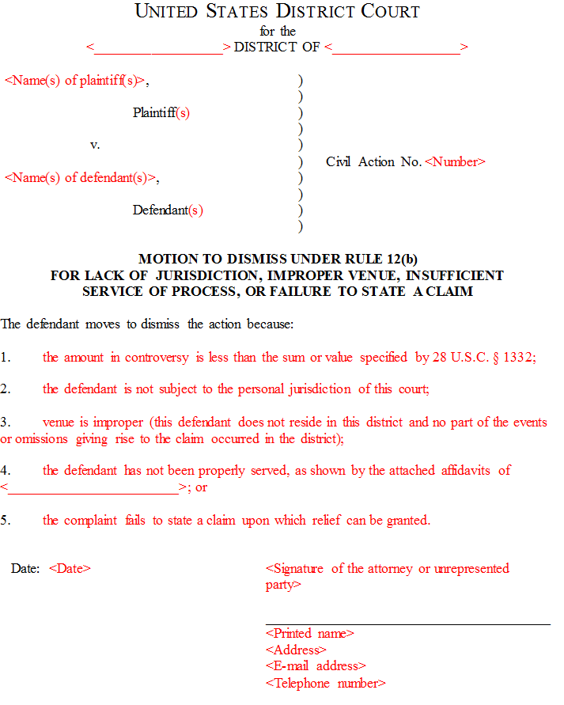

Slide 33
FRCP 12(b) How to Present Defenses. Every defense to a claim for relief in any pleading must be asserted in the responsive pleading if one is required. But a party may assert the following defenses by motion: (1) lack of subject-matter jurisdiction; (2) lack of personal jurisdiction; (3) improper venue; (4) insufficient process; (5) insufficient service of process; (6) failure to state a claim upon which relief can be granted; and (7) failure to join a party under Rule 19.

Slide 34
FRCP 12(b): “No defense or objection is waived by joining it with one or more other defenses or objections in a responsive pleading or in a motion.”

Slide 35
If, on a motion under Rule 12(b)(6) or 12(c), matters outside the pleadings are presented to and not excluded by the court, the motion must be treated as one for summary judgment under Rule 56. All parties must be given a reasonable opportunity to present all the material that is pertinent to the motion.

Slide 36
FRCP 12(c) Motion for Judgment on the Pleadings. After the pleadings are closed—but early enough not to delay trial—a party may move for judgment on the pleadings

Slide 37
12(e) Motion for a More Definite Statement. A party may move for a more definite statement of a pleading to which a responsive pleading is allowed but which is so vague or ambiguous that the party cannot reasonably prepare a response. The motion must be made before filing a responsive pleading and must point out the defects complained of and the details desired. If the court orders a more definite statement and the order is not obeyed within 14 days after notice of the order or within the time the court sets, the court may strike the pleading or issue any other appropriate order.

Slide 38
12(f) Motion to Strike. The court may strike from a pleading an insufficient defense or any redundant, immaterial, impertinent, or scandalous matter. The court may act: (1) on its own; or (2) on motion made by a party either before responding to the pleading or, if a response is not allowed, within 21 days after being served with the pleading.

Slide 39
timing

Slide 40
FRCP 12(a) Time to Serve a Responsive Pleading. (1) In General. Unless another time is specified by this rule or a federal statute, the time for serving a responsive pleading is as follows: (A) A defendant must serve an answer: (i) within 21 days after being served with the summons and complaint; or (ii) if it has timely waived service under Rule 4(d), within 60 days after the request for a waiver was sent . . . (B) A party must serve an answer to a counterclaim or crossclaim within 21 days after being served with the pleading that states the counterclaim or crossclaim. (C) A party must serve a reply to an answer within 21 days after being served with an order to reply, unless the order specifies a different time.

Slide 41
12(a)(4) Effect of a Motion. Unless the court sets a different time, serving a motion under this rule alters these periods as follows: (A) if the court denies the motion or postpones its disposition until trial, the responsive pleading must be served within 14 days after notice of the court’s action; or (B) if the court grants a motion for a more definite statement, the responsive pleading must be served within 14 days after the more definite statement is served.

Slide 42
Matos v. Nextran, Inc. (D.V.I. 2009)

Slide 43
waiver of defenses

Slide 44
FRCP 12(g) Joining Motions. (1) Right to Join. A motion under this rule may be joined with any other motion allowed by this rule. (2) Limitation on Further Motions. Except as provided in Rule 12(h)(2) or (3), a party that makes a motion under this rule must not make another motion under this rule raising a defense or objection that was available to the party but omitted from its earlier motion. (h) Waiving and Preserving Certain Defenses. (1) When Some Are Waived. A party waives any defense listed in Rule 12(b)(2)-(5) by: (A) omitting it from a motion in the circumstances described in Rule 12(g)(2); or (B) failing to either: (i) make it by motion under this rule; or (ii) include it in a responsive pleading or in an amendment allowed by Rule 15(a)(1) as a matter of course. (2) When to Raise Others. Failure to state a claim upon which relief can be granted, to join a person required by Rule 19(b), or to state a legal defense to a claim may be raised: (A) in any pleading allowed or ordered under Rule 7(a); (B) by a motion under Rule 12(c); or (C) at trial. (3) Lack of Subject-Matter Jurisdiction. If the court determines at any time that it lacks subject-matter jurisdiction, the court must dismiss the action.

Slide 45
SMJ – can bring up at any time

Slide 46
failure to state claim, failure to join necessary party: if you bring up in a pre-answer motion under R 12, you can’t bring it up in a second pre-answer motion (unless it was not available to you at the time) but you can bring it up in your answer or later

Slide 47
pj, venue, process, service If you submit a pre-answer motion under R 12, it must be in it – it cannot be brought up in a second pre-answer motion (unless it was not available to you at the time) If your first response is instead an answer it must be in it (unless you can add it through an amendment “as a matter of course”)

Slide 48
- P serves D in suit for battery - Within 21 days D makes a motion to dismiss for lack of PJ - D’s motion is rejected by the court - May D make another pre-answer motion to dismiss for improper venue? - May D introduce venue as a defense in his answer? - May D introduce failure to state a claim in a second pre-answer motion? - In his answer? - After the pleading period? - May D introduce lack of SMJ in a second pre-answer motion? - In his answer? - After the pleading period?

Slide 49
P serves D in suit for battery Within 21 days D answers May D include with that answer the defense of lack of PJ? After the answer may D make a motion to dismiss for lack of SMJ? After the answer, may D ask for a judgment on the pleadings on the ground that P fails to state a claim? After the answer, may D make a motion to dismiss for insufficient service? May D save the defense of insufficient service by including it the answer by an amendment under R. 15 “as a matter of course”?

Slide 50
P serves D in suit for battery Within 21 days D makes a motion for a more definite statement and a motion to dismiss for lack of PJ The court grants the motion for a more definite statement but denies the motion to dismiss P responds to the motion for a more definite statement, serving D with an amended complaint D makes a motion to dismiss for failure to state a claim and a motion to dismiss for insufficient service

Slide 51
Hunter v. Serv-Tech Inc. (E.D. La. 2009)

Slide 52
answers

Slide 53
defenses in an answer 1) PJ, SMJ, venue, service, process 2) failure to state a claim 3) negative defenses 4) affirmative defenses

Slide 54
FRCP 8(b) Defenses; Admissions and Denials. (1) In General. In responding to a pleading, a party must: (A) state in short and plain terms its defenses to each claim asserted against it; and (B) admit or deny the allegations asserted against it by an opposing party.

Slide 55
FRCP 8(c) Affirmative Defenses. (1) In General. In responding to a pleading, a party must affirmatively state any avoidance or affirmative defense, including: • accord and satisfaction; • arbitration and award; • assumption of risk; • contributory negligence; • discharge in bankruptcy; • duress; • estoppel; • failure of consideration; • fraud; • illegality; • injury by fellow servant; • laches; • license; • payment; • release; • res judicata; • statute of frauds; • statute of limitations; and • waiver.

Slide 56
8(c)(2) Mistaken Designation. If a party mistakenly designates a defense as a counterclaim, or a counterclaim as a defense, the court must, if justice requires, treat the pleading as though it were correctly designated, and may impose terms for doing so.

Slide 57
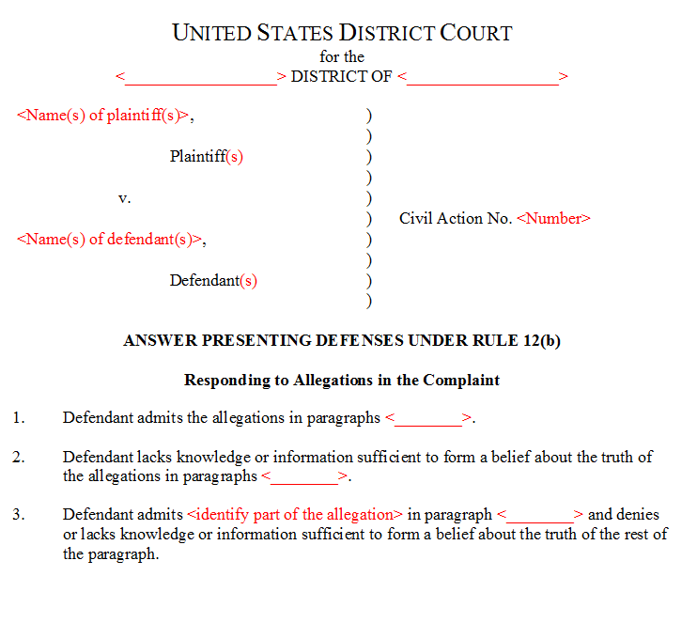

Slide 58
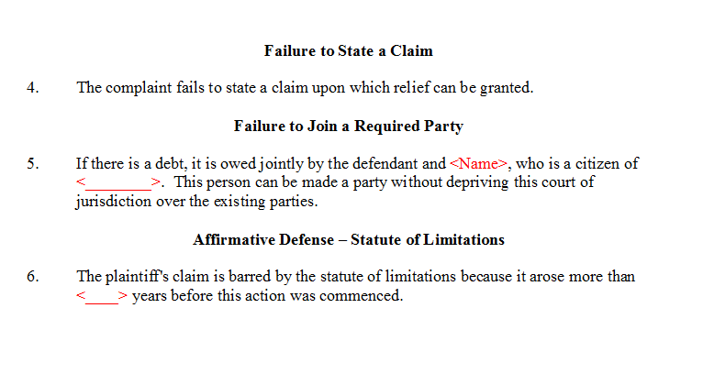

Slide 59
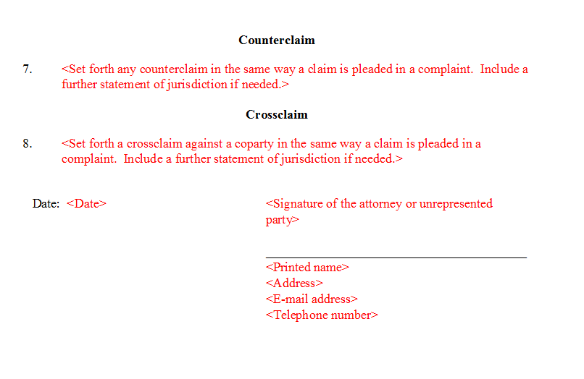

Slide 60
Reis Robotics USA, Inc. v. Concept Industries, Inc. (N.D. Ill. 2006)

Slide 61
motion to strike affirmative defenses

Slide 62
Concept's first affirmative defense is nothing more than a recitation of the standard for a motion to dismiss under Rule 12(b)(6). As alleged, the defense provides no explanation as to how and in what portion of the complaint Reis has failed to state a claim.

Slide 63
is failure to state a claim an affirmative defense?

Slide 64
On Wednesday, September 27, 2017 at 2:41 p.m., Defendant Jefferson Hunt intentionally failed to praise Plaintiff Michael Green for Plaintiff’s exemplary lecture on civil procedure, in circumstances in which praise would have been reasonable, thereby causing Plaintiff substantial psychological distress.

Slide 65
As its second affirmative defense Concept states: “Reis breached the contract on which it purports to rely, and that contract may be void for fraud and/or failure of consideration.”

Slide 66
As its third affirmative defense, Concept alleges: “Reis's payment claims for the silencer fixture are barred because Concept never authorized Reis to begin manufacturing the fixture, as Reis itself has acknowledged.”

Slide 67
Concept's fifth affirmative defense states: “Reis's claims are barred or limited by laches, waiver, estoppel, unclean hands, or similar legal or equitable doctrines.”

Slide 68
Concept's sixth affirmative defense states: “Concept reserves the right to add additional affirmative defenses as they become known through discovery.”

Slide 69
motion to strike admissions/denials

Slide 70
“To the extent the alleged ‘contract’ created by issuance of this purchase order failed to warrant the trim speed and cycle time that Concept required, it was procured by fraud and was of no validity; accordingly, the remaining allegations in this paragraph are denied as true.”

Slide 71
P alleges that D was negligent D answers – “to the extent that the plaintiff was contributorily negligent this is denied”

Slide 72
what is an affirmative defense?

Slide 73
Ingraham v. United States (5th Cir. 1987)

Slide 74
Tex.Rev.Civ.Stat.Ann. art. 4590i, § 11.02(a), In an action on a health care liability claim where final judgment is rendered against a physician or health care provider, the limit of civil liability for damages of the physician or health care provider shall be limited to an amount not to exceed $500,000. (b) Subsection (a) of this section does not apply to the amount of damages awarded on a health care liability claim for the expenses of necessary medical, hospital, and custodial care received before judgment or required in the future for treatment of the injury.

