Slide 1
Mon., Oct. 2

Slide 2
dismissal for improper venue

Slide 3
transfer from a district without venue to one with venue

Slide 4
28 U.S.C. § 1406. CURE OR WAIVER OF DEFECTS (a) The district court of a district in which is filed a case laying venue in the wrong division or district shall dismiss, or if it be in the interest of justice, transfer such case to any district or division in which it could have been brought.

Slide 5
transfer from a district with venue to a more convenient one with venue

Slide 6
28 U.S.C. § 1404. CHANGE OF VENUE (a) For the convenience of parties and witnesses, in the interest of justice, a district court may transfer any civil action to any other district or division where it might have been brought or to any district or division to which all parties have consented.

Slide 7
As to the second showing, the statute calls on the court to weigh a number of case-specific private and public-interest factors. The private-interest considerations include: (1) the plaintiff’s choice of forum, unless the balance of convenience is strongly in favor of the defendants; (2) the defendant’s choice of forum; (3) whether the claim arose elsewhere; (4) the convenience of the parties; (5) the convenience of the witnesses; and (6) the ease of access to sources of proof. The public-interest considerations include: (1) the transferee’s familiarity with the governing laws; (2) the relative congestion of the calendars of the potential transferee and transferor courts; and (3) the local interest in deciding local controversies at home.

Slide 8
Van Dusen v. Barrack, 376 U.S. 612 (1964)

Slide 9
dismissal from a district with venue so that it can be brought outside of the United States

Slide 10
forum non conveniens

Slide 11
drafting a complaint

Slide 12
purposes served by a complaint (and answer)

Slide 13
notice to defendant narrow dispute identify actions that can be dismissed pre-trial/discovery - wrong forum - failure to state a claim - inadequate evidentiary support…?

Slide 14
history of pleading

Slide 15
code pleading – no “conclusory allegations” - ultimate facts (no evidence or conclusions of law)

Slide 16
D negligently drove…

Slide 17
code pleading – state each cause of action separately

Slide 18
modern approach: notice pleading

Slide 19
- Rule 8. General Rules of Pleading (a) Claim for Relief. A pleading that states a claim for relief must contain: … (2) a short and plain statement of the claim showing that the pleader is entitled to relief; …

Slide 20
can you be conclusory in your pleading under 8(a)?

Slide 21
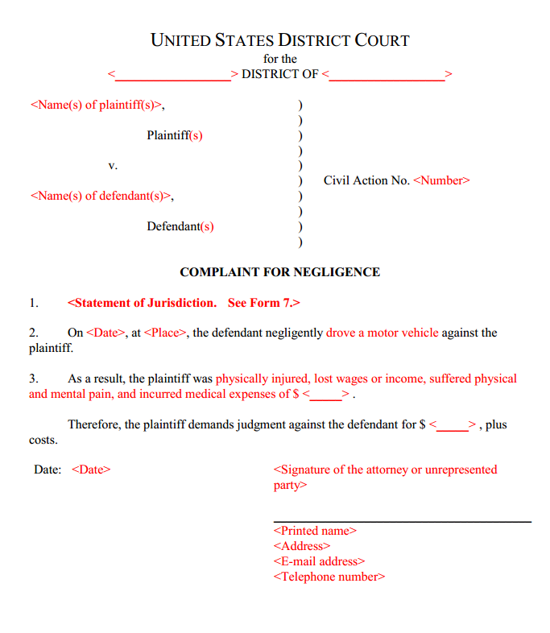

Slide 22
focus is on a claim (a transaction) – need not specify the cause of action

Slide 23
procedure for addressing the three things that can be wrong with the (non-jurisdictional) factual allegations in a complaint under the Federal Rules system: 1) legal insufficiency 2) inadequate specificity (even to satisfy 8(a)(2)) 3) lack of evidentiary support to justify discovery/trial

Slide 24
1 legal sufficiency of factual allegations do they state a claim?

Slide 25
how does the D bring up the problem of legal insufficiency?

Slide 26
motion to dismiss for failure to state a claim/defense of failure to state a claim in one’s answer leave to amend

Slide 27
FRCP 12(b) How to Present Defenses. Every defense to a claim for relief in any pleading must be asserted in the responsive pleading if one is required. But a party may assert the following defenses by motion: (1) lack of subject-matter jurisdiction; (2) lack of personal jurisdiction; (3) improper venue; (4) insufficient process; (5) insufficient service of process; (6) failure to state a claim upon which relief can be granted; and (7) failure to join a party under Rule 19. ...

Slide 28
2 level of specificity in factual allegations are the factual allegations in the complaint specific enough?

Slide 29
- Rule 8. General Rules of Pleading (a) Claim for Relief. A pleading that states a claim for relief must contain: ...(2) a short and plain statement of the claim showing that the pleader is entitled to relief...

Slide 30
how does the D bring up the problem of lack of specificity?

Slide 31
FRCP 12(e) Motion for a More Definite Statement. A party may move for a more definite statement of a pleading to which a responsive pleading is allowed but which is so vague or ambiguous that the party cannot reasonably prepare a response. The motion must be made before filing a responsive pleading and must point out the defects complained of and the details desired. If the court orders a more definite statement and the order is not obeyed within 14 days after notice of the order or within the time the court sets, the court may strike the pleading or issue any other appropriate order.

Slide 32
3 evidentiary support for factual allegations

Slide 33
how is the D bring up this problem?

Slide 34
Rule 11. Signing Pleadings, Motions, and Other Papers; Representations to the Court; Sanctions ...(b) Representations to the Court. By presenting to the court a pleading, written motion, or other paper — whether by signing, filing, submitting, or later advocating it — an attorney or unrepresented party certifies that to the best of the person’s knowledge, information, and belief, formed after an inquiry reasonable under the circumstances: ...(3) the factual contentions have evidentiary support or, if specifically so identified, will likely have evidentiary support after a reasonable opportunity for further investigation or discovery; ...

Slide 35
Rule 56. Summary Judgment (a) Motion for Summary Judgment or Partial Summary Judgment. A party may move for summary judgment, identifying each claim or defense — or the part of each claim or defense — on which summary judgment is sought. The court shall grant summary judgment if the movant shows that there is no genuine dispute as to any material fact and the movant is entitled to judgment as a matter of law. The court should state on the record the reasons for granting or denying the motion. ...

Slide 36
what problems exist with these factual allegations…?

Slide 37
Defendant Jefferson Hunt intentionally engaged in contact with the person of Plaintiff Michael Green that was harmful or offensive, causing damages.

Slide 38
On Wednesday, September 27, 2017 at 2:41 p.m., Defendant Jefferson Hunt intentionally failed to praise Plaintiff Michael Green for Plaintiff’s exemplary lecture on civil procedure, in circumstances in which praise would have been reasonable, thereby causing Plaintiff substantial psychological distress.

Slide 39
On Wednesday, September 27, 2017 at 2:41 p.m., Defendant Jefferson Hunt hit Plaintiff Michael Green in the face, causing him extensive physical harm.

Slide 40
can the battery complaint be dismissed at the pleading stage?

Slide 41
why can’t you always get to discovery then?

Slide 42
why have this system?

Slide 43
in the cases in the Glannon chapter, distinguish two types of challenges of the plaintiff’s complaint

Slide 44
1 - D is not claiming that the P does not have evidentiary support for the allegations - D is worried that what is alleged does not add up to a violation of the law (some element of a cause of action looks like it is missing)

Slide 45
for example…. assume that under the relevant law there is no strict liability for product defects, only negligence liability P alleges that D manufactured the product “improperly”

Slide 46
Conley v. Gibson, 355 U.S. 41 (1957)

Slide 47
Conley v. Gibson “complaint should not be dismissed for failure to state a claim unless it appears beyond doubt that the plaintiff can prove no set of facts in support of his claim which would entitle him to relief”

Slide 48
Defendant Jefferson Hunt intentionally engaged in contact with the person of Plaintiff Michael Green that was harmful or offensive, causing damages.

Slide 49
On Wednesday, September 27, 2017 at 2:41 p.m., Defendant Jefferson Hunt hit Plaintiff Michael Green in the face, causing him extensive physical harm.

Slide 50
2 - D thinks P does not have evidentiary support for the allegations - all the elements for a cause of action are there but the D thinks that P will not be able to prove an element (that is why the P lacks specificity)

Slide 51
assume that under the relevant law there is no strict liability for product defects, only negligence liability P alleges that D manufactured the product “negligently” without saying how it was negligent

Slide 52
cases of the first type…

Slide 53
Dioguardi v. Durning (2d Cir. 1944)

Slide 54
Doe v. Smith (7th Cir. 2005)

Slide 55
federal wiretapping statute 18 U.S.C. §§ 2510-22

Slide 56
any person who “intentionally intercepts…any wire, oral, or electronic communication” § 2511(1)(a)

Slide 57
The first question is whether Doe could show, without contradicting any of the complaint's allegations, that Smith captured a “wire, oral, or electronic communication.”

Slide 58
Next comes the question whether Smith “intercepted” the oral communication.

Slide 59
“intercept” means “the aural or other acquisition of the contents of any wire, electronic, or oral communication through the use of any electronic, mechanical, or other device” 18 U.S.C. § 2510(4)

Slide 60
and (c) intentionally discloses…to any other person the contents of any wire, oral, or electronic communication, knowing or having reason to know that the information was obtained through the interception of a wire, oral, or electronic communication in violation of this subsection; ․․ shall be subject to suit as provided in subsection (5)

Slide 61
Liability generally requires proof that the interception or disclosure occurred in or through the means of interstate commerce, such as the telephone network.

Slide 62
The statute provides some defenses, such as consent. Any one private participant's consent usually suffices. 18 U.S.C. § 2511(2)(d).

Slide 63
It shall not be unlawful under this chapter for a person not acting under color of law to intercept a wire, oral, or electronic communication where such person is a party to the communication or where one of the parties to the communication has given prior consent to such interception unless such communication is intercepted for the purpose of committing any criminal or tortious act in violation of the Constitution or laws of the United States or of any State.

Slide 64
inconsistent pleading

Slide 65
Rule 8. General Rules of Pleading ... (d) Pleading to Be Concise and Direct; Alternative Statements; Inconsistency. (1) In General. Each allegation must be simple, concise, and direct. No technical form is required. (2) Alternative Statements of a Claim or Defense. A party may set out two or more statements of a claim or defense alternatively or hypothetically, either in a single count or defense or in separate ones. If a party makes alternative statements, the pleading is sufficient if any one of them is sufficient. (3) Inconsistent Claims or Defenses. A party may state as many separate claims or defenses as it has, regardless of consistency.

Slide 66
pleading special matters (fraud)

Slide 67
Rule 9. Pleading Special Matters ... (b) Fraud or Mistake; Conditions of Mind. In alleging fraud or mistake, a party must state with particularity the circumstances constituting fraud or mistake. Malice, intent, knowledge, and other conditions of a person’s mind may be alleged generally.

Slide 68
Why the heightened pleading standards for fraud?

Slide 69
fraud
- statement (omission if duty to speak)
- of material fact
- that is false (or misleading)
- with knowledge of falsity
often intent that plaintiff rely
- reasonable reliance on statement by plaintiff
- causation of damages

Slide 70
Does R 9(b) apply to affirmative defenses?

Slide 71
Why the exception in 9(b) for scienter?

Slide 72
Leatherman (US 1993)

Slide 73
Bell Atlantic Corp. v. Twombly (U.S. 2007)

Slide 74
did the plaintiffs fail to state a claim?

Slide 75
Paragraph 4 Plaintiffs allege that Defendants entered into a contract, combination or conspiracy to prevent competitive entry in their respective local telephone and/or high speed internet services markets by, among other things, agreeing not to compete with one another and to stifle attempts by others to compete with them and otherwise allocating customers and markets to one another.

Slide 76
Paragraph 51 “In the absence of any meaningful competition between the [baby bells] in one another’s markets, and in light of the parallel course of conduct that each engaged in to prevent competition from [locals] within their respective local telephone and/or high speed internet services markets and the other facts and market circumstances alleged above, Plaintiffs allege upon information and belief that Defendants have entered into a contract, combination or conspiracy to prevent entry in their respective local telephone and/or high speed internet service markets and have agreed not to compete with one another and otherwise allocated customers and markets to one another.”

Slide 77
Stevens’s dissent: But the plaintiffs allege in three places in their complaint, ¶¶ 4, 51, 64, App. 11, 27, 30, that the [baby bells] did in fact agree both to prevent competitors from entering into their local markets and to forgo competition with each other. And as the Court recognizes, at the motion to dismiss stage, a judge assumes “that all the allegations in the complaint are true (even if doubtful in fact).”

Slide 78
The majority circumvents this obvious obstacle to dismissal by pretending that it does not exist. The Court admits that “in form a few stray statements in the complaint speak directly of agreement,” but disregards those allegations by saying that “on fair reading these are merely legal conclusions resting on the prior allegations” of parallel conduct. Ante, at 1970. The Court's dichotomy between factual allegations and “legal conclusions” is the stuff of a bygone era, supra, at 1976 - 1977.

Slide 79
what 8(a)(2) violated then?

Slide 80
were the defendants not put on notice about the nature of the alleged agreement?

Slide 81
how can an agreement in restraint of trade arise? must there always be a “handshake”?

Slide 82
how do you show a tacit agreement?

Slide 83
imagine that there was a trial and all that the Ps offered for evidence of an agreement was this parallel behavior? what result?

Slide 84
the real problem is evidentiary support…

