Slide 1
Thurs., Sep. 28

Slide 2
venue in federal court

Slide 3
Sec. 1391. - Venue generally (b) Venue in general.--A civil action may be brought in-- (1) a judicial district in which any defendant resides, if all defendants are residents of the State in which the district is located; (2) a judicial district in which a substantial part of the events or omissions giving rise to the claim occurred, or a substantial part of property that is the subject of the action is situated;

Slide 4
Uffner v. La Reunion Francaise (1st Cir. 2001)

Slide 5
8th Cir. – defendant must be responsible for the event/omission in district and it has to be an element of the cause of action

Slide 6
(c) Residency.--For all venue purposes-- (1) a natural person, including an alien lawfully admitted for permanent residence in the United States, shall be deemed to reside in the judicial district in which that person is domiciled;

Slide 7
1391(c)(3) a defendant not resident in the United States may be sued in any judicial district, and the joinder of such a defendant shall be disregarded in determining where the action may be brought with respect to other defendants.

Slide 8
Residence of corporations and unincorporated associations: § 1391(c)(2) an entity with the capacity to sue and be sued in its common name under applicable law, whether or not incorporated, shall be deemed to reside, if a defendant, in any judicial district in which such defendant is subject to the court's personal jurisdiction with respect to the civil action in question

Slide 9
(d) Residency of corporations in States with multiple districts.--For purposes of venue under this chapter, in a State which has more than one judicial district and in which a defendant that is a corporation is subject to personal jurisdiction at the time an action is commenced, such corporation shall be deemed to reside in any district in that State within which its contacts would be sufficient to subject it to personal jurisdiction if that district were a separate State, and, if there is no such district, the corporation shall be deemed to reside in the district within which it has the most significant contacts.

Slide 10
1391(b)(3) if there is no district in which an action may otherwise be brought as provided in this section, any judicial district in which any defendant is subject to the court's personal jurisdiction with respect to such action.

Slide 11
dismissal for improper venue

Slide 12
transfer from a district without venue to one with venue

Slide 13
28 U.S.C. § 1406. CURE OR WAIVER OF DEFECTS (a) The district court of a district in which is filed a case laying venue in the wrong division or district shall dismiss, or if it be in the interest of justice, transfer such case to any district or division in which it could have been brought.

Slide 14
waiver of the defense of venue

Slide 15
may a court bring up lack of venue sua sponte?

Slide 16
transfer from a district with venue to a more convenient one with venue

Slide 17
28 U.S.C. § 1404. CHANGE OF VENUE (a) For the convenience of parties and witnesses, in the interest of justice, a district court may transfer any civil action to any other district or division where it might have been brought or to any district or division to which all parties have consented.

Slide 18
dismissal from a district with venue so that it can be brought outside of the United States

Slide 19
forum non conveniens

Slide 20
MACMUNN v. ELI LILLY CO. 559 F. Supp. 2d 58 (D.D.C. 2008)

Slide 21
why did the plaintiff choose DC?

Slide 22
why is removal possible?

Slide 23
why is there venue in D.D.C.?

Slide 24
why was there PJ in DC?

Slide 25
As to the second showing, the statute calls on the court to weigh a number of case-specific private and public-interest factors. The private-interest considerations include: (1) the plaintiff’s choice of forum, unless the balance of convenience is strongly in favor of the defendants; (2) the defendant’s choice of forum; (3) whether the claim arose elsewhere; (4) the convenience of the parties; (5) the convenience of the witnesses; and (6) the ease of access to sources of proof. The public-interest considerations include: (1) the transferee’s familiarity with the governing laws; (2) the relative congestion of the calendars of the potential transferee and transferor courts; and (3) the local interest in deciding local controversies at home.

Slide 26
shouldn’t the transfer lead to dismissal on statute of limitations grounds?

Slide 27
Van Dusen v. Barrack, 376 U.S. 612 (1964)

Slide 28
forum selection clauses

Slide 29
forum non conveniens

Slide 30
PIPER AIRCRAFT CO. v. REYNO 454 U.S. 235 (1981)

Slide 31
drafting a complaint

Slide 32
Rule 10. Form of Pleadings Caption; Names of Parties. Every pleading must have a caption with the court’s name, a title, a file number, and a Rule 7(a) designation. The title of the complaint must name all the parties; the title of other pleadings, after naming the first party on each side, may refer generally to other parties.

Slide 33
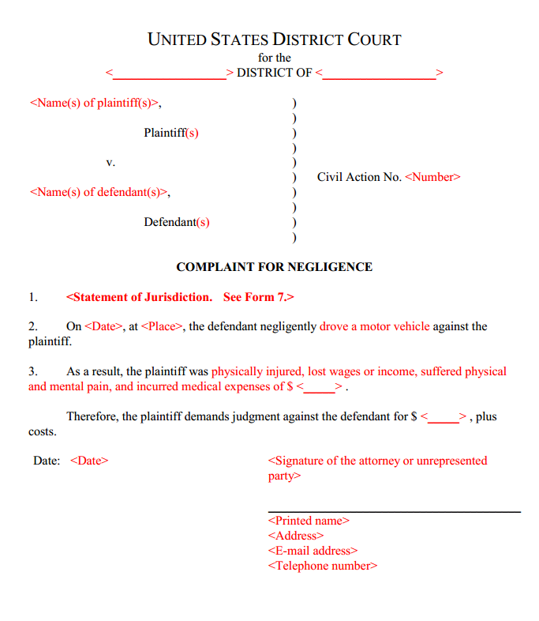

Slide 34
- Rule 8. General Rules of Pleading (a) Claim for Relief. A pleading that states a claim for relief must contain: (1) a short and plain statement of the grounds for the court’s jurisdiction, unless the court already has jurisdiction and the claim needs no new jurisdictional support; (2) a short and plain statement of the claim showing that the pleader is entitled to relief; and (3) a demand for the relief sought, which may include relief in the alternative or different types of relief.

Slide 35
Rule 10(b) Paragraphs; Separate Statements. A party must state its claims or defenses in numbered paragraphs, each limited as far as practicable to a single set of circumstances. A later pleading may refer by number to a paragraph in an earlier pleading. If doing so would promote clarity, each claim founded on a separate transaction or occurrence — and each defense other than a denial — must be stated in a separate count or defense.

Slide 36
what purposes does a complaint serve?

Slide 37
what purpose does service of a complaint on the defendant serve?

Slide 38
what purpose does the answer to a complaint serve?

Slide 39
what role might the complaint with answer play in: discovery? trial?

Slide 40
how might a defendant point to what is in a complaint to weed out an action that should not proceed to discovery/trial?

Slide 41
wrong forum failure to state a claim frivolousness – inadequate evidentiary support

Slide 42
how do the Federal Rules limit frivolous actions?

Slide 43
Rule 11 discovery – summary judgment

Slide 44
is there any way to dismiss on the basis of inadequate evidentiary support at the pleading stage?

Slide 45
history of pleading

Slide 46
1) common law pleading/equity pleading 2) reform through Field Code - called “fact” or “code” pleading

Slide 47
code pleading – no “conclusory allegations” - ultimate facts (no evidence or conclusions of law)

Slide 48
D negligently drove…

