Slide 1
Wed., Sep. 27

Slide 2
service

Slide 3
“statutory” interpretation

Slide 4
4(c) Service. … (2) By Whom. Any person who is at least 18 years old and not a party may serve a summons and complaint.

Slide 5
4(e) Serving an Individual Within a Judicial District of the United States. Unless federal law provides otherwise, an individual — other than a minor, an incompetent person, or a person whose waiver has been filed — may be served in a judicial district of the United States by:

Slide 6
(1) following state law for serving a summons in an action brought in courts of general jurisdiction in the state where the district court is located or where service is made; or…

Slide 7
(2) doing any of the following: (A) delivering a copy of the summons and of the complaint to the individual personally; (B) leaving a copy of each at the individual’s dwelling or usual place of abode with someone of suitable age and discretion who resides there; or (C) delivering a copy of each to an agent authorized by appointment or by law to receive service of process.

Slide 8
(h) Serving a Corporation, Partnership, or Association. …must be served: (1) in a judicial district of the United States: (A) in the manner prescribed by Rule 4(e)(1) for serving an individual; or (B) by delivering a copy of the summons and of the complaint to an officer, a managing or general agent, or any other agent authorized by appointment or by law to receive service of process and — if the agent is one authorized by statute and the statute so requires — by also mailing a copy of each to the defendant...

Slide 9
venue in federal court

Slide 10
- statutory, not a constitutional issue - about federal districts, not states - applicable only in federal court system - rough measure of convenience

Slide 11
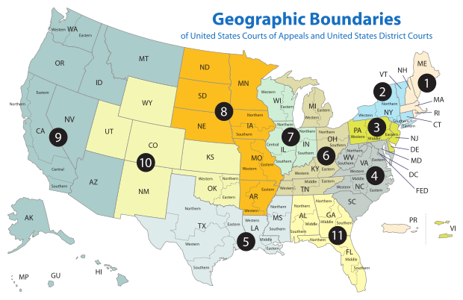

Slide 12
Sec. 1391. - Venue generally (b) Venue in general.--A civil action may be brought in-- (1) a judicial district in which any defendant resides, if all defendants are residents of the State in which the district is located; (2) a judicial district in which a substantial part of the events or omissions giving rise to the claim occurred, or a substantial part of property that is the subject of the action is situated;

Slide 13
(c) Residency.--For all venue purposes-- (1) a natural person, including an alien lawfully admitted for permanent residence in the United States, shall be deemed to reside in the judicial district in which that person is domiciled;

Slide 14
P (San. Fran. – N.D. Cal.) sues D1 (NYC – S.D.N.Y.) & D2 (Buffalo – W.D.N.Y.) - suit is under 42 U.S.C. § 1983 concerning an allegedly unlawful arrest that occurred in an airport in NJ (D.N.J.) - where is there venue?

Slide 15
P (San. Fran. – N.D. Cal.) sues D1 (NYC – S.D.N.Y.) & D2 (Conn. – D. Conn.) - suit is under 42 U.S.C. § 1983 concerning an allegedly unlawful arrest that occurred in New Jersey (D.N.J.) - where is there venue?

Slide 16
P (San. Fran. – N.D. Cal.) sues D1 (NYC – S.D.N.Y.) & D2 (Conn. – D. Conn.) - suit is a Cal. state law breach of contract action concerning a contract signed in San Francisco for the construction of a hospital in Albany (N.D.N.Y.) - P claims hospital is not according to plans - where is there venue?

Slide 17
P (San. Fran. – N.D. Cal.) sues D1 (a German domiciled in Germany) & D2 (Conn. – D. Conn.) - suit is a Cal. state law breach of contract action concerning a contract signed in San Francisco for the construction of a hospital in Albany (N.D.N.Y.) - P claims hospital is not according to plans - where is there venue?

Slide 18
1391(c)(3) a defendant not resident in the United States may be sued in any judicial district, and the joinder of such a defendant shall be disregarded in determining where the action may be brought with respect to other defendants.

Slide 19
P (San. Fran. – N.D. Cal.) sues D (an illegal alien domiciled in N.D. Cal.) - suit is a Cal. state law breach of contract action concerning a contract signed in San Francisco for the construction of a hospital in Albany (N.D.N.Y.) - P claims hospital is not according to plans - where is there venue?

Slide 20
Residence of corporations and unincorporated associations: § 1391(c)(2) an entity with the capacity to sue and be sued in its common name under applicable law, whether or not incorporated, shall be deemed to reside, if a defendant, in any judicial district in which such defendant is subject to the court's personal jurisdiction with respect to the civil action in question

Slide 21
(d) Residency of corporations in States with multiple districts.--For purposes of venue under this chapter, in a State which has more than one judicial district and in which a defendant that is a corporation is subject to personal jurisdiction at the time an action is commenced, such corporation shall be deemed to reside in any district in that State within which its contacts would be sufficient to subject it to personal jurisdiction if that district were a separate State, and, if there is no such district, the corporation shall be deemed to reside in the district within which it has the most significant contacts.

Slide 22
P (San Francisco – N.D. Cal.) sues the D1 Corp. & the D2 Corp. - suit is a Cal. state law breach of contract action concerning a contract signed in San Francisco (N.D. Cal.) for the construction of a hospital in Albany (N.D.N.Y.) - D1 Corp. built foundation; D2 Corp. built structure - D1 Corp. incorporated in Delaware (D. Del.); main office in NYC (S.D.N.Y.); large branch office in Philadelphia (E.D. Pa.) D2 Corp. incorporated in Delaware (D. Del.); main office in Pittsburgh (W.D. Pa.); large branch office in Boston (D. Mass.) - where is there venue?

Slide 23
1391(b)(3) if there is no district in which an action may otherwise be brought as provided in this section, any judicial district in which any defendant is subject to the court's personal jurisdiction with respect to such action.

Slide 24
P (S.F. – N.D. Cal.) sues the D1 (S.D.N.Y) & D2 (E.D. Pa) - suit is breach of contract action concerning a contract signed in San Francisco for the construction of a hospital in Paris - D1 built foundation; D2 built structure - where is there venue?

Slide 25
P (S.F. – N.D. Cal.) sues the D1 (S.D.N.Y) & D2 (E.D. Pa.) - suit is breach of contract action concerning a contract signed in London for the construction of a hospital in Paris - D1 built foundation; D2 built structure - where is there venue?

Slide 26
venue and removal

Slide 27
assume that in World-Wide Volkswagen the action had been originally been brought in federal court in the E.D. Okla. (where the accident occurred) set aside PJ and SMJ. is there venue?

Slide 28
Uffner v. La Reunion Francaise (1st Cir. 2001)

Slide 29
dismissal for improper venue

Slide 30
transfer from a district without venue to one with venue

Slide 31
transfer occurs only within a court system

Slide 32
28 U.S.C. § 1406. CURE OR WAIVER OF DEFECTS (a) The district court of a district in which is filed a case laying venue in the wrong division or district shall dismiss, or if it be in the interest of justice, transfer such case to any district or division in which it could have been brought.

Slide 33
P (NYC – in SDNY) sues D (Buffalo – in WDNY) under PA contract law in the D. Del. concerning a contract entered into in Phil. (E.D. Pa.) with performance to occur in Phil. may the court transfer to the E.D. Pa. under 1406?

Slide 34
P (NYC – in SDNY) sues D (Boston – in D. Mass.) under PA contract law in the D. Del. concerning a contract entered into in Phil. (E.D. Pa.) with performance to occur in Phil. may the court transfer to the E.D. Pa. under 1406?

Slide 35
waiver of the defense of venue

Slide 36
may a court bring up lack of venue sua sponte?

Slide 37
transfer from a district with venue to a more convenient one with venue

Slide 38
28 U.S.C. § 1404. CHANGE OF VENUE (a) For the convenience of parties and witnesses, in the interest of justice, a district court may transfer any civil action to any other district or division where it might have been brought or to any district or division to which all parties have consented.

Slide 39
dismissal from a district with venue so that it can be brought outside of the United States

Slide 40
forum non conveniens

