Slide 1
Wed., Sep. 20

Slide 2
where do we stand…?

Slide 3
PJ cases that can be answered within the Int’l Shoe framework, without considering the relationship to the Pennoyer framework: - specific personal jurisdiction (with the addition of the McGee factors) e.g, McGee, Burger King, Worldwide VW, Asahi, McIntyre - general personal jurisdiction over corporations e.g. Goodyear, Daimler

Slide 4
PJ under the Pennoyer framework that is unproblematic under Int’l Shoe - domicile as a source in general in personam jurisdiction over individuals - in rem

Slide 5
the problematic cases are when PJ exists under the Pennoyer framework but does not satisfy Int’l Shoe - some we know are unconstitutional - certain types of quasi in rem Shaffer

Slide 6
why no PJ in Shaffer?

Slide 7
- because all forms of PJ must satisfy Int’l Shoe? (Shaffer, Brennan in Burnham)

Slide 8
- because all forms of PJ over an-out-of-state defendant must satisfy Int’l Shoe? (Scalia in Burnham) - tagging does not have to satisfy Int’l Shoe because the defendant is in state - all forms of quasi in rem are unconstitutional though

Slide 9
- because all forms of PJ over an out-of-state defendant in which in personam jurisdiction is ultimately asserted must satisfy Int’l Shoe? (Scalia in Burnham) - tagging does not have to satisfy Int’l Shoe because the defendant is in state - quasi in rem in Shaffer was a problem because limited appearances were not allowed - had they been allowed it would have been constitutional

Slide 10
- because a form of PJ under Pennoyer is unconstitutional if the defendant could not have reasonably anticipated that his actions would submit him to personal jurisdiction? (WWVW, Stevens and Powell in Shaffer) - the defendants in Shaffer could not have reasonably anticipated PJ in Del simply by buying shares in a Del corp - but quasi in rem concerning real property and bank accounts is OK

Slide 11
also Brennan in Burnham The transient rule is consistent with reasonable expectations, and is entitled to a strong presumption that it comports with due process. “If I visit another State, . . . I knowingly assume some risk that the State will exercise its power over my property or my person while there. My contact with the State, though minimal, gives rise to predictable risks.” Shaffer (STEVENS, J., concurring in judgment); see also Burger King Corp. v. Rudzewicz (1985) ("[t]erritorial presence frequently will enhance a potential defendant's affiliation with a State and reinforce the reasonable foreseeability of suit there")

Slide 12
because a form of PJ that was accepted at the time of the enactment of the 14th Amendment and generally used by the states today is constitutionally permissible? (Scalia in Burnham: “Where, however, as in the present case, a jurisdictional principle is both firmly approved by tradition and still favored, it is impossible to imagine what standard we could appeal to for the judgment that it is ‘no longer justified.’”) expanded by Int’l Shoe, but not contracted

Slide 13
Burnham v. Superior Court (U.S. 1990)

Slide 14
Scalia’s opinion (with Rehnquist, Kennedy and White)?

Slide 15
Glannon: “Justice Scalia and three other justices concluded that the Shaffer opinion really meant to say that assertions of in personam, quasi in rem, and in rem jurisdiction had to meet the Int’l Shoe standard, not that Int’l Shoe applied to other bases for personal jurisdiction, like transient presence.”

Slide 16
Brennan (with Marshall, Blackmun, and O’Connor)?

Slide 17
set aside tagging – does PJ in Burnham satisfy Int’l Shoe?

Slide 18
Scalia on Brennan?

Slide 19
Brennan’s response?

Slide 20
what about the McGee factors…?

Slide 21
D is lured into a state and tagged PJ?

Slide 22
Terlizzi v. Brodie, 329 N.Y.S.2d 589 (N.Y. App. Div. 1972)

Slide 23
the CEO of the D. Corp is tagged in CA PJ in CA?

Slide 24
A, a partner of the partnership, A & B, is tagged in CA PJ in CA?

Slide 25
A is domiciled in CT B is domiciled in NJ A & B’s offices and all of its work is done out of NY where is there in personam PJ (setting aside tagging)?

Slide 26
NY makes the appointment of an agent for service of process a condition for doing business in NY can this create general jurisdiction?

Slide 27
waiver/consent

Slide 28
state long arm statutes

Slide 29
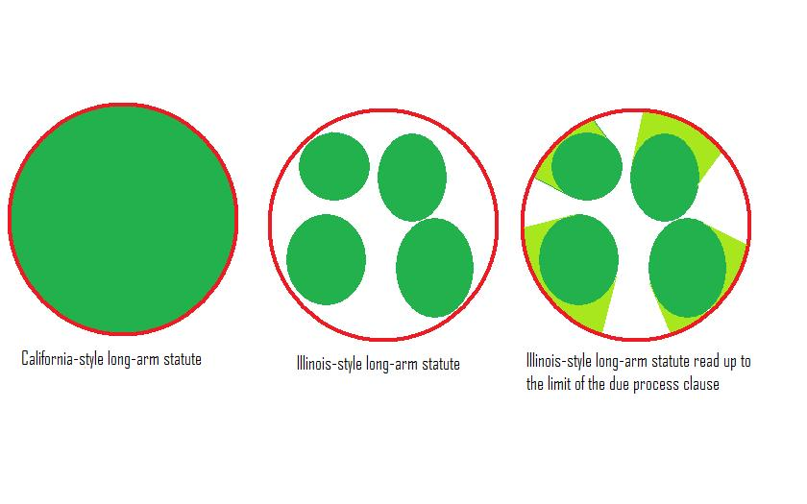

Slide 30
P sues D in state court in New York D defaults P sues on the default judgment in state court in CA D argues that NY state court did not have PJ under the 14th Amendment should D offer any other arguments?

Slide 31
common law personal jurisdiction

Slide 32
PJ in federal court

Slide 33
U.S. Const. Amendment V. No person shall . . . be deprived of life, liberty, or property, without due process of law . . .

Slide 34
- P (NY) sues D (NJ) for a state law battery that occurred in New York City. - P brings the suit in federal court in Alaska - D is served in NJ - D has never visited Alaska and has never had any contact with the state

Slide 35
Rule 4. Summons (k) Territorial Limits of Effective Service. (1) In General. Serving a summons or filing a waiver of service establishes personal jurisdiction over a defendant: (A) who is subject to the jurisdiction of a court of general jurisdiction in the state where the district court is located; … (C) when authorized by a federal statute.

Slide 36
(2) Federal Claim Outside State-Court Jurisdiction. For a claim that arises under federal law, serving a summons or filing a waiver of service establishes personal jurisdiction over a defendant if: (A) the defendant is not subject to jurisdiction in any state’s courts of general jurisdiction; and (B) exercising jurisdiction is consistent with the United States Constitution and laws.

Slide 37
- P (Va.) brings suit in federal court in Virginia against D, a German domiciliary residing in Germany, for a battery that the German committed against him in New York - D has no other contacts with the United States besides the brief trip to NY during which the alleged battery occurred - D is served in Germany Is there PJ?

Slide 38
Saudi terrorist is sued under a federal antiterrorism act allowing for American victims of foreign terrorism to sue for damages - the alleged acts of terrorism in this case occurred in Saudi Arabia - the action is brought in federal court in New York. Is there PJ?

Slide 39
Is there PJ? All actions are brought in the Southern District of New York...

Slide 40
A federal civil rights action concerning the defendant’s arrest of the plaintiff in Buffalo, NY. Defendant lives in Pennsylvania and is served there.

Slide 41
- a California state-law product liability action concerning a product P bought in Cal that harmed him in Cal - suit is against C Corp, incorporated in Delaware with its principal place of business in Tennessee - D Corp has a large factory and branch office in Buffalo, New York (with 10,000 employees) - the D Corp is served (through service on its Chief Legal Officer) in NYC

Slide 42
- a California state-law diversity action concerning a brawl between the plaintiff and the defendant in California - the plaintiff is a citizen of California and the defendant a citizen of New York - the defendant is served while on a business trip in California

Slide 43
- an action by P (NY) against D (Germany) for breach of German contract law concerning a contract signed in Germany with performance in Germany - at the initiation of the suit P had the federal court attach the assets of a trust that had been created by the German’s mother with the German as the beneficiary - the assets of the trust and the trustee are located in New York City - defendant is served in Germany

Slide 44
- an action by P (NY) against D (Cal) for violation of a federal antiterrorism act - D’s alleged violations of the federal act were all committed in Iraq - D is served in Cal

Slide 45
while WWVW is going on, the Robinsons are sued by P (OK) for non-payment of medical fees sustained in OK PJ?

