Slide 1
Thurs., Oct. 13

Slide 2
venue in federal court

Slide 3
- statutory, not a constitutional issue - about federal districts, not states - applicable only in federal court system - rough measure of convenience

Slide 4
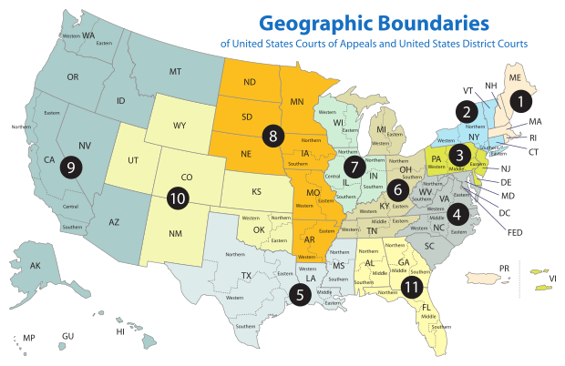

Slide 5
Sec. 1391. - Venue generally (b) Venue in general.--A civil action may be brought in-- (1) a judicial district in which any defendant resides, if all defendants are residents of the State in which the district is located; (2) a judicial district in which a substantial part of the events or omissions giving rise to the claim occurred, or a substantial part of property that is the subject of the action is situated;

Slide 6
(c) Residency.--For all venue purposes-- (1) a natural person, including an alien lawfully admitted for permanent residence in the United States, shall be deemed to reside in the judicial district in which that person is domiciled;

Slide 7
1391(c)(3) a defendant not resident in the United States may be sued in any judicial district, and the joinder of such a defendant shall be disregarded in determining where the action may be brought with respect to other defendants.

Slide 8
P (San. Fran. – N.D. Cal.) sues D1 (NYC – S.D.N.Y.) & D2 (Buffalo – W.D.N.Y.) Suit is under 42 U.S.C. § 1983 concerning an allegedly unlawful arrest that occurred in an airport in NJ (D.N.J.)

Slide 9
P (San. Fran. – N.D. Cal.) sues D1 (NYC – S.D.N.Y.) & D2 (Conn. – D. Conn.) Suit is under 42 U.S.C. § 1983 concerning an allegedly unlawful arrest that occurred in New Jersey (D.N.J.)

Slide 10
P (San. Fran. – N.D. Cal.) sues D1 (NYC – S.D.N.Y.) & D2 (Conn. – D. Conn.) - Suit is a Cal. state law breach of contract action concerning a contract signed in San Francisco for the construction of a hospital in Albany (N.D.N.Y.) - P claims hospital is not according to plans

Slide 11
Residence of corporations and unincorporated associations: § 1391(c)(2) an entity with the capacity to sue and be sued in its common name under applicable law, whether or not incorporated, shall be deemed to reside, if a defendant, in any judicial district in which such defendant is subject to the court's personal jurisdiction with respect to the civil action in question

Slide 12
(d) Residency of corporations in States with multiple districts.--For purposes of venue under this chapter, in a State which has more than one judicial district and in which a defendant that is a corporation is subject to personal jurisdiction at the time an action is commenced, such corporation shall be deemed to reside in any district in that State within which its contacts would be sufficient to subject it to personal jurisdiction if that district were a separate State, and, if there is no such district, the corporation shall be deemed to reside in the district within which it has the most significant contacts.

Slide 13
P (S.F. – N.D. Cal.) sues the D1 Corp. & the D2 Corp. Suit is a Cal. state law breach of contract action concerning a contract signed in San Francisco for the construction of a hospital in Albany (N.D.N.Y.) D1 Corp. built foundation; D2 Corp. built structure D1 Corp. incorporated in Delaware (D. Del.); main office in NYC (S.D.N.Y.); large branch office in Philadelphia (E.D. Pa.) D2 Corp. incorporated in Delaware (D. Del.); main office in Pittsburgh (W.D. Pa.); large branch office in Boston (D. Mass.)

Slide 14
1391(b)(3) if there is no district in which an action may otherwise be brought as provided in this section, any judicial district in which any defendant is subject to the court's personal jurisdiction with respect to such action.

Slide 15
P (S.F. – N.D. Cal.) sues the D1 (S.D.N.Y) & D2 (E.D. Pa) Suit is breach of contract action concerning a contract signed in San Francisco for the construction of a hospital in Paris D1 built foundation; D2 built structure

Slide 16
P (S.F. – N.D. Cal.) sues the D1 (S.D.N.Y) & D2 (E.D. Pa) Suit is breach of contract action concerning a contract signed in London for the construction of a hospital in Paris D1 built foundation; D2 built structure

Slide 17
SMJ PJ Venue

Slide 18
P(NJ) sues D(NY) in D.N.J. for +$75K for breach of a contract entered into in NY with performance in NY. D is served in NJ.

Slide 19
P(NJ) sues D(NJ) in the S.D.N.Y. for +$75K for violation of his federal civil rights due to D’s arrest of P in Manhattan (in the S.D.N.Y.). D is served in NJ.

Slide 20
P(NJ) sues D(NY) in the D.N.J. for +$75K for negligence because he bought a pen from D in NY and took it home to NJ where it exploded. D is served in NY.

Slide 21
P(NJ) sues D(NJ) in the D.N.J. for +$75K for breach of a contract entered into in NJ with performance in NJ. D is served in NJ.

Slide 22
P(NY) sues D(NJ) in the S.D.N.Y. for $40K for breach of a contract entered into in the S.D.N.Y. with performance in the S.D.N.Y. and for $40K for a brawl that occurred between the two in NJ. D is served in NJ.

Slide 23
P(NY) sues D(NJ) in the S.D.N.Y. for $40K for breach of a contract entered into in the S.D.N.Y. with performance in the N.D.N.Y. and for $40K for a brawl that occurred between the two in NJ. D is served in the S.D.N.Y.

