Slide 1
Wed., Oct. 12

Slide 2
review session today – Rm. 141

Slide 3
PERSONAL JURISDICTION IN STATE COURT

Slide 4
Shaffer v. Heitner (US 1977)

Slide 5
“We therefore conclude that all assertions of state-court jurisdiction must be evaluated according to the standards set forth in International Shoe and its progeny.”

Slide 6
Burnham v. Superior Court (U.S. 1990)

Slide 7
Scalia?

Slide 8
Brennan?

Slide 9
Five Considerations - Pennoyer - International Shoe power theory - McGee factors - Reasonably able to anticipate PJ due to actions - Scalia’s theory – OK if OK under Int’l Shoe but also OK if OK under Pennoyer and still used by states today

Slide 10
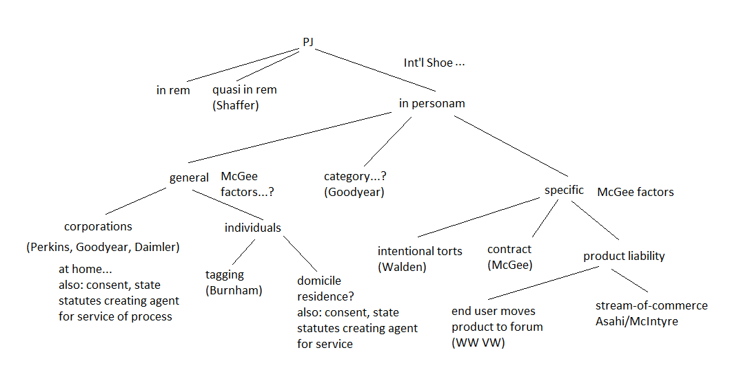

Slide 11
P (a citizen of Nebraska) sues D (a citizen of New York) for $100,000 damages in Nebraska state court in connection with a brawl that occurred in Illinois. D has never been to the state of Nebraska and owns no property there. D appears to argue that the Nebraska state court lacks personal jurisdiction over her. Under Nebraska state law, however, motions to dismiss for lack of personal jurisdiction are not allowed: Anyone appearing before a Nebraska state court, even when arguing lack of personal jurisdiction, submits himself to general personal jurisdiction.

Slide 12
- D Corp (Ore) manufactures thimbles - engaged in a national search to locate a suitable engineer to work at its only manufacturing plant, located Medford, Ore - search involved advertisements in a trade publication with a national circulation - used a company that specializes in recruiting highly trained employees - recruitment company located P, who lived in Yreka, California – only 50 miles from Medford, Oregon - a letter sent from the D Corp’s main office in Medford to P’s home in Yreka, the D Corp offered P a job, and P accepted - P decided to continue living in Yreka and to commute the fifty miles to work. - P got into a serious accident working on a machine at the Oregon factory - sued D Corp under state-law negligence concerning the maintenance of the machine in Cal. state ct - D Corp’s other contacts with the state of California are the following: - The D Corp’s thimbles are sold all over the world, including in California, although distribution of the thimbles is through an independent distributing company that takes ownership of them at the D Corp plant in Oregon - The D Corp sells about 100,000 thimbles per year in California - The California sales of its thimbles amount to around $10,000 per year and constitute around 3% of the D Corp’s total yearly production - D Corp does not advertise its thimbles in California, nor does it own property, maintain an office, or have an agent for service of process there. -PJ?

Slide 13
PJ in federal court

Slide 14
U.S. Const. Amendment V. No person shall . . . be deprived of life, liberty, or property, without due process of law . . .

Slide 15
Rule 4. Summons (k) Territorial Limits of Effective Service. (1) In General. Serving a summons or filing a waiver of service establishes personal jurisdiction over a defendant: (A) who is subject to the jurisdiction of a court of general jurisdiction in the state where the district court is located; … (C) when authorized by a federal statute.

Slide 16
- P (NY) sues D (NJ) for a state law battery that occurred in New York City. - P brings the suit in federal court in Alaska - D is served in NJ - D has never visited Alaska and has never had any contact with the state

Slide 17
(2) Federal Claim Outside State-Court Jurisdiction. For a claim that arises under federal law, serving a summons or filing a waiver of service establishes personal jurisdiction over a defendant if: (A) the defendant is not subject to jurisdiction in any state’s courts of general jurisdiction; and (B) exercising jurisdiction is consistent with the United States Constitution and laws.

Slide 18
P (Va.) brings suit in federal court in Virginia against D, a German domiciliary residing in Germany, for a battery that the German committed against him in New York. The German has no other contacts with the United States besides the brief trip to NY during which the alleged battery occurred. Is there PJ?

Slide 19
Saudi terrorist is sued under a federal antiterrorism act allowing for American victims of foreign terrorism to sue for damages. (The alleged acts of terrorism in this case occurred in Saudi Arabia.) The action is brought in federal court in New York. Is there PJ?

Slide 20
Is there PJ? All actions are brought in the Southern District of New York...

Slide 21
A federal civil rights action concerning the defendant’s arrest of the plaintiff in Buffalo, NY. Defendant lives in Pennsylvania and is served there.

Slide 22
A California state-law product liability action brought as a diversity action by a California plaintiff against a corporation incorporated in Delaware with its principal place of business in Tennessee. The defendant corporation has a large factory and branch office in Buffalo, New York (with 10,000 employees) but the plaintiff at no time has this asset of the corporation attached by the federal court. The defendant corporation is served (through service on its Chief Legal Officer) in Tennessee.

Slide 23
A California state-law diversity action concerning a brawl between the plaintiff and the defendant in California. The plaintiff is a citizen of California and the defendant a citizen of New York. The defendant is served while on a business trip in California.

Slide 24
An action by a New York plaintiff against a German defendant for breach of German contract law concerning a contract signed in Germany with performance in Germany. At the initiation of the suit the American plaintiff had the federal court attach the assets of a trust that had been created by the German’s mother with the German as the beneficiary. The assets of the trust and the trustee are located in New York City. Defendant is served in Germany.

Slide 25
An action by a New York citizen against a California citizen for violation of a federal antiterrorism act. The defendant’s alleged violations of the federal act were all committed in Iraq. The defendant has no contacts with the state of New York.

Slide 26
venue in federal court

Slide 27
- statutory, not a constitutional issue - about federal districts, not states - applicable only in federal court system - rough measure of convenience

Slide 28
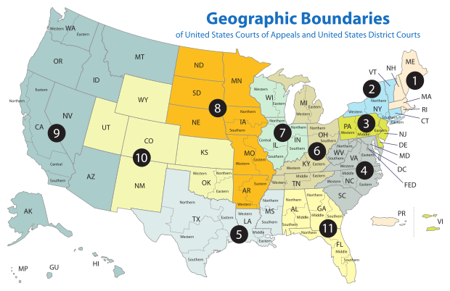

Slide 29
Sec. 1391. - Venue generally (b) Venue in general.--A civil action may be brought in-- (1) a judicial district in which any defendant resides, if all defendants are residents of the State in which the district is located; (2) a judicial district in which a substantial part of the events or omissions giving rise to the claim occurred, or a substantial part of property that is the subject of the action is situated;

Slide 30
(c) Residency.--For all venue purposes-- (1) a natural person, including an alien lawfully admitted for permanent residence in the United States, shall be deemed to reside in the judicial district in which that person is domiciled;

Slide 31
1391(c)(3) a defendant not resident in the United States may be sued in any judicial district, and the joinder of such a defendant shall be disregarded in determining where the action may be brought with respect to other defendants.

Slide 32
P (San. Fran. – N.D. Cal.) sues D1 (NYC – S.D.N.Y.) & D2 (Buffalo – W.D.N.Y.) Suit is under 42 U.S.C. § 1983 concerning an allegedly unlawful arrest that occurred in an airport in NJ (D.N.J.)

Slide 33
P (San. Fran. – N.D. Cal.) sues D1 (NYC – S.D.N.Y.) & D2 (Conn. – D. Conn.) Suit is under 42 U.S.C. § 1983 concerning an allegedly unlawful arrest that occurred in New Jersey (D.N.J.)

Slide 34
P (San. Fran. – N.D. Cal.) sues D1 (NYC – S.D.N.Y.) & D2 (Conn. – D. Conn.) - Suit is a Cal. state law breach of contract action concerning a contract signed in San Francisco for the construction of a hospital in Albany (N.D.N.Y.) - P claims hospital is not according to plans

Slide 35
Residence of corporations and unincorporated associations: § 1391(c)(2) an entity with the capacity to sue and be sued in its common name under applicable law, whether or not incorporated, shall be deemed to reside, if a defendant, in any judicial district in which such defendant is subject to the court's personal jurisdiction with respect to the civil action in question

Slide 36
(d) Residency of corporations in States with multiple districts.--For purposes of venue under this chapter, in a State which has more than one judicial district and in which a defendant that is a corporation is subject to personal jurisdiction at the time an action is commenced, such corporation shall be deemed to reside in any district in that State within which its contacts would be sufficient to subject it to personal jurisdiction if that district were a separate State, and, if there is no such district, the corporation shall be deemed to reside in the district within which it has the most significant contacts.

Slide 37
P (S.F. – N.D. Cal.) sues the D1 Corp. & the D2 Corp. Suit is a Cal. state law breach of contract action concerning a contract signed in San Francisco for the construction of a hospital in Albany (N.D.N.Y.) D1 Corp. built foundation; D2 Corp. built structure D1 Corp. incorporated in Delaware (D. Del.); main office in NYC (S.D.N.Y.); large branch office in Philadelphia (E.D. Pa.) D2 Corp. incorporated in Delaware (D. Del.); main office in Pittsburgh (W.D. Pa.); large branch office in Boston (D. Mass.)

Slide 38
1391(b)(3) if there is no district in which an action may otherwise be brought as provided in this section, any judicial district in which any defendant is subject to the court's personal jurisdiction with respect to such action.

Slide 39
P (S.F. – N.D. Cal.) sues the D1 (S.D.N.Y) & D2 (E.D. Pa) Suit is breach of contract action concerning a contract signed in San Francisco for the construction of a hospital in Paris D1 built foundation; D2 built structure

Slide 40
P (S.F. – N.D. Cal.) sues the D1 (S.D.N.Y) & D2 (E.D. Pa) Suit is breach of contract action concerning a contract signed in London for the construction of a hospital in Paris D1 built foundation; D2 built structure

Slide 41
SMJ PJ Venue

Slide 42
P(NJ) sues D(NY) in D.N.J. for +$75K for breach of a contract entered into in NY with performance in NY. D is served in NJ.

Slide 43
P(NJ) sues D(NJ) in the S.D.N.Y. for +$75K for violation of his federal civil rights due to D’s arrest of P in Manhattan (in the S.D.N.Y.). D is served in NJ.

Slide 44
P(NJ) sues D(NY) in the D.N.J. for +$75K for negligence because he bought a pen from D in NY and took it home to NJ where it exploded. D is served in NY.

Slide 45
P(NJ) sues D(NJ) in the D.N.J. for +$75K for breach of a contract entered into in NJ with performance in NJ. D is served in NJ.

Slide 46
P(NY) sues D(NJ) in the S.D.N.Y. for $40K for breach of a contract entered into in the S.D.N.Y. with performance in the S.D.N.Y. and for $40K for a brawl that occurred between the two in NJ. D is served in NJ.

Slide 47
P(NY) sues D(NJ) in the S.D.N.Y. for $40K for breach of a contract entered into in the S.D.N.Y. with performance in the N.D.N.Y. and for $40K for a brawl that occurred between the two in NJ. D is served in the S.D.N.Y.

