Slide 1
Mon., Oct. 3

Slide 2
PERSONAL JURISDICTION IN STATE COURT

Slide 3
general in personam personal jurisdiction over corporations

Slide 4
GOODYEAR DUNLOP TIRES OPERATIONS, S. A., v. EDGAR D. BROWN U.S. S.Ct. - June 27, 2011

Slide 5
“For an individual, the paradigm forum for the exercise of general jurisdiction is the individual’s domicile; for a corporation, it is an equivalent place, one in which the corporation is fairly regarded as at home.”

Slide 6
Daimler AG v. Bauman January 14, 2014

Slide 7
specific jurisdiction

Slide 8
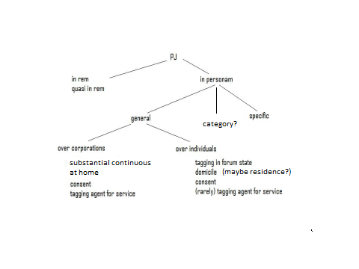

Slide 9
McGee v. Int’l Life Ins. Co. (US 1957)

Slide 10
It cannot be denied that California has a manifest interest in providing effective means of redress for its residents when their insurers refuse to pay claims. These residents would be at a severe disadvantage if they were forced to follow the insurance company to a distant State in order to hold it legally accountable. When claims were small or moderate individual claimants frequently could not afford the cost of bringing an action in a foreign forum - thus in effect making the company judgment proof. Often the crucial witnesses - as here on the company's defense of suicide - will be found in the insured's locality. Of course there may be inconvenience to the insurer if it is held amenable to suit in California where it had this contract but certainly nothing which amounts to a denial of due process.

Slide 11
Int’l Shoe theory of power v. convenience/reasonableness (or “McGee factors”)

Slide 12
- Californian calls Oregonian and offers him $100,000 if he performs work in Nevada. - The Oregonian has made no advertisements encouraging offers. - The Oregonian agrees. - The Californian sends the Oregonian $50,000 as a deposit. - The Oregonian performs the work. - The Californian thinks the work is sub-standard and refuses to give the Oregonian the other $50,000. - Is there PJ in California state court for the Californian's suit against the Oregonian for return of the $50,000 deposit?

Slide 13
- Same as above. - Is there PJ in Oregon state court for the Oregonian's suit against the Californian for the remaining $50,000 under the contract?

Slide 14
Same as above. - Is there PJ in Nevada state court for the Californian's suit against the Oregonian? For the Oregonian's suit against the Californian?

Slide 15
Chung v. NANA Development Corp. 783 F.2d 1124 (4th Cir. 1986)

Slide 16
- Va. P goes to Alaska to buy reindeer horns from Alaska D. - Wants them to remain frozen. - Requests that the D ship some of them to him in Va. - When they arrive in Va. they are melted. - P sues D in federal court in Va. PJ?

Slide 17
Thompson v. Chrysler Motors Corp. 755 F.2d 1162 (5th Cir. 1985)

Slide 18
- Miss. P goes to Ala. D to buy car. - Returns with car to Miss. - Car has problems, P makes many phone calls to Ala. and returns a number of times to Ala. for repair. - Finally D ships a master cylinder to P in Miss. for use in repair there. - Cylinder is defective and accident occurs. - P sues D in Miss. state court. PJ?

Slide 19
Bensusan Restaurant Corp., v. King, 937 F.Supp. 295 (S.D.N.Y. 1996)

Slide 20
- Bensusan, the operator of a New York jazz club, sued the operator of a Missouri jazz club for trademark infringement. - The internet web site at issue contained general information about the defendant's club, a calendar of events and ticket information. - However, the site was not interactive. - If a user wanted to go to the club, she would have to call or visit a ticket outlet and then pick up tickets at the club on the night of the show.

Slide 21
World-Wide Volkswagen v. Woodson (U.S. 1980)

Slide 22
writ of prohibition writ of mandamus

Slide 23
Okla.Stat., Tit. 12, § 1701.03(a)(4) (1971) A court may exercise personal jurisdiction over a person, who acts directly or by an agent, as to a cause of action or claim for relief arising from the person's . . . causing tortious injury in this state by an act or omission outside this state if he regularly does or solicits business or engages in any other persistent course of conduct, or derives substantial revenue from goods used or consumed or services rendered, in this state . . . .

Slide 24
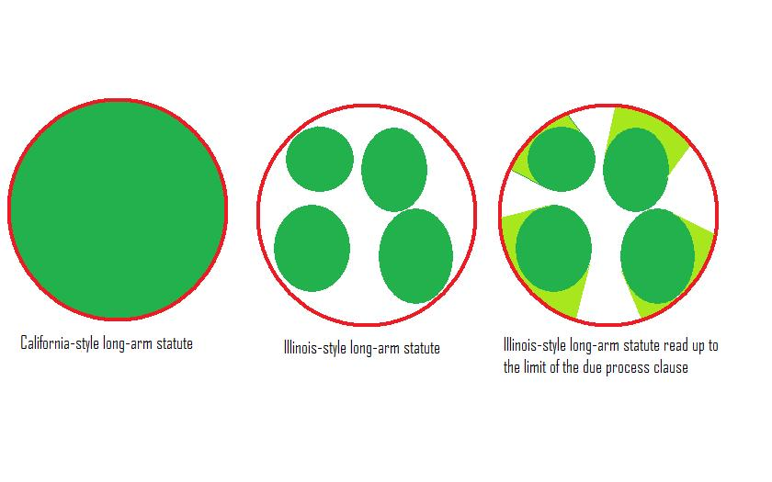

Slide 25
The concept of minimum contacts, in turn, can be seen to perform two related, but distinguishable, functions. It protects the defendant against the burdens of litigating in a distant or inconvenient forum. And it acts to ensure that the States through their courts, do not reach out beyond the limits imposed on them by their status as coequal sovereigns in a federal system. The protection against inconvenient litigation is typically described in terms of "reasonableness" or "fairness."

Slide 26
Even if the defendant would suffer minimal or no inconvenience from being forced to litigate before the tribunals of another State; even if the forum State has a strong interest in applying its law to the controversy; even if the forum State is the most convenient location for litigation, the Due Process Clause, acting as an instrument of interstate federalism, may sometimes act to divest the State of its power to render a valid judgment.

Slide 27
Ohio v. Wyandotte Chemicals (U.S. 1971)

Slide 28
stream of commerce

Slide 29
This is not to say, of course, that foreseeability is wholly irrelevant. But the foreseeability that is critical to due process analysis is not the mere likelihood that a product will find its way into the forum State. Rather, it is that the defendant's conduct and connection with the forum State are such that he should reasonably anticipate being haled into court there.

Slide 30
Asahi Metal Industry Co. v. Superior Court (U.S. 1987)

Slide 31
Justice O'CONNOR announced the judgment of the Court and delivered the unanimous opinion of the Court with respect to Part I, the opinion of the Court with respect to Part II-B, in which THE CHIEF JUSTICE, Justice BRENNAN, Justice WHITE, Justice MARSHALL, Justice BLACKMUN, Justice POWELL, and Justice STEVENS join, and an opinion with respect to Parts II-A and III, in which THE CHIEF JUSTICE, Justice POWELL, and Justice SCALIA join.

Slide 32
Part II-B – O’Connor, Rehnquist, Brennan, White, Marshall, Blackmun, Powell, Stevens Part II-A - O’Connor, Rehnquist, Powell, Scalia

Slide 33
Part II-B

Slide 34
We have previously explained that the determination of the reasonableness of the exercise of jurisdiction in each case will depend on an evaluation of several factors. A court must consider the burden on the defendant, the interests of the forum State, and the plaintiff's interest in obtaining relief. It must also weigh in its determination "the interstate judicial system's interest in obtaining the most efficient resolution of controversies; and the shared interest of the several States in furthering fundamental substantive social policies." (O'Connor II.B)

Slide 35
Part II-A

Slide 36
Additional conduct of the defendant may indicate an intent or purpose to serve the market in the forum State, for example, designing the product for the market in the forum State, advertising in the forum State, establishing channels for providing regular advice to customers in the forum State, or marketing the product through a distributor who has agreed to serve as the sales agent in the forum State. But a defendant's awareness that the stream of commerce may or will sweep the product into the forum State does not convert the mere act of placing the product into the stream into an act purposefully directed toward the forum State. (O'Connor II.A)

Slide 37
Asahi sells all of its valves to Cheng Shin. Cheng Shin just happens to sell all its products in CA and Asahi knows this. Power over Asahi in CA?

Slide 38
Brennan’s concurrence Brennan, White, Marshall, Blackmun

Slide 39
As long as a participant in this process is aware that the final product is being marketed in the forum State, the possibility of a lawsuit there cannot come as a surprise. Nor will the litigation present a burden for which there is no corresponding benefit. A defendant who has placed goods in the stream of commerce benefits economically from the retail sale of the final product in the forum State, and indirectly benefits from the State's laws that regulate and facilitate commercial activity. (Brennan, concurring)

Slide 40
Stevens’s concurrence

Slide 41
The plurality seems to assume that an unwavering line can be drawn between "mere awareness" that a component will find its way into the forum State and "purposeful availment" of the forum's market. Over the course of its dealings with Cheng Shin, Asahi has arguably engaged in a higher quantum of conduct than "[t]he placement of a product into the stream of commerce, without more...." Whether or not this conduct rises to the level of purposeful availment requires a constitutional determination that is affected by the volume, the value, and the hazardous character of the components. In most circumstances I would be inclined to conclude that a regular course of dealing that results in deliveries of over 100,000 units annually over a period of several years would constitute "purposeful availment" even though the item delivered to the forum State was a standard product marketed throughout the world. (Stevens, concurring – with White and Blackmun)

